Slide 1

Post Determination Process for Project Managers
May 2025

Slide 2
Overview
Types of Departure Records (slide 3)
Post Determination filter for DAS 3 records (slide 4)
How to run Post Determination Reports for schemes covering DAS 2 and DAS 3 departures (slides 5 -10)
How to understand the raw data (slides 11-12)
Post Determination actions (slides 13 -16)
Guidance (slides 17 -19)
Please note: Any links referred to in the video can be accessed in the accompanying PowerPoint slide deck published underneath the training video

Slide 3

Types of Departure Records
DAS 2 Version of the database was used up to 29th March 2019 and uses departure IDs <100,000
DAS 3 Version of the database from 29th March 2019, to present and will use departure IDs > 100,000
DAS 3 Version has all historic DAS 2 records, but certain search filters are only available for DAS 3 records

Slide 4
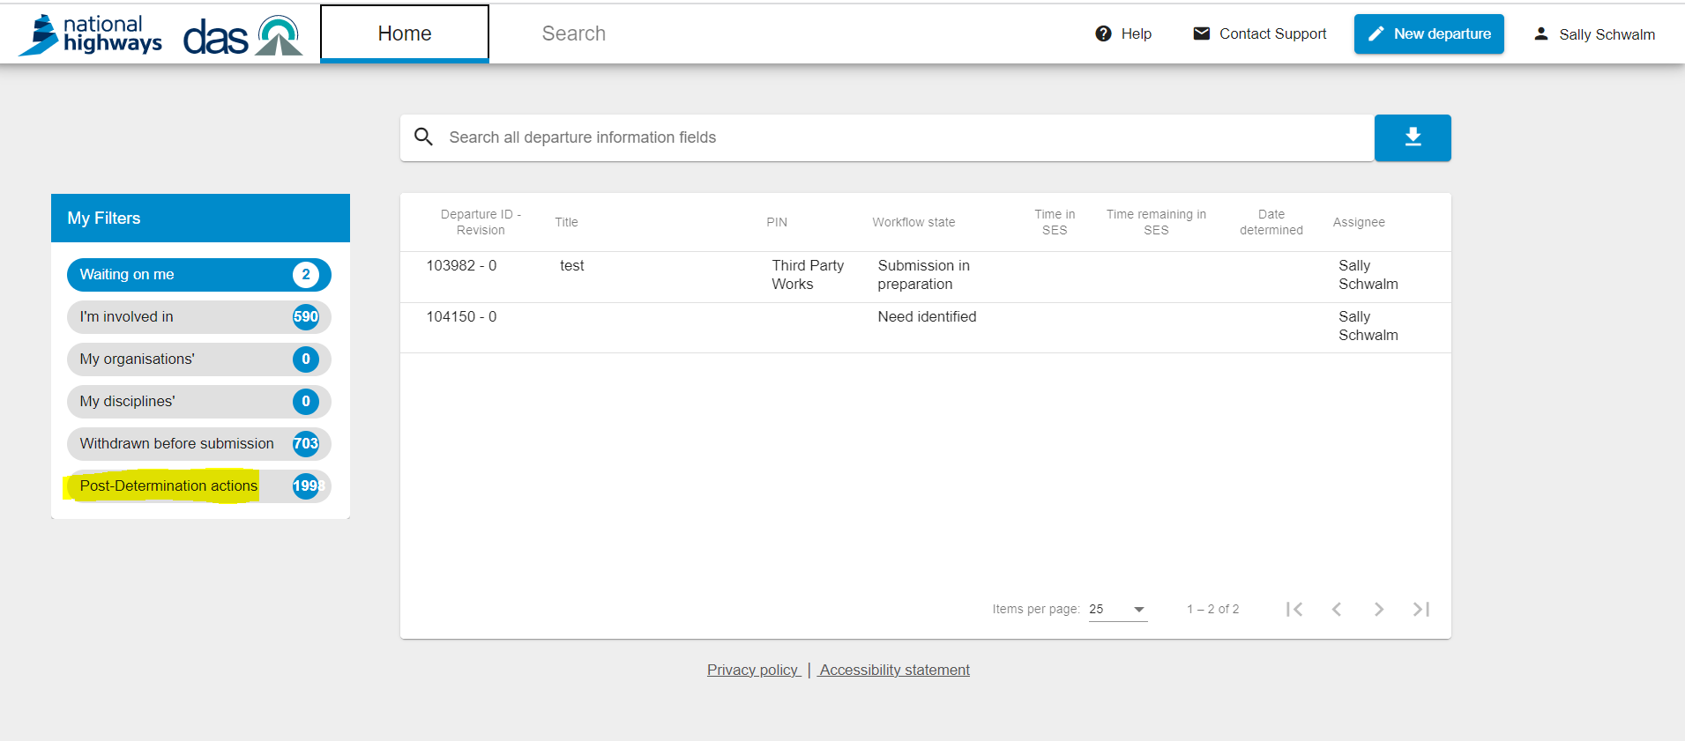
DAS 3 Departures at Post Determination
DAS Home Page accessed via this link - https://departures.highwaysengland.co.uk/
Remember this only displays DAS 3 records and not DAS 2
If your departures were submitted on DAS 3 i.e. from ID 100000 onwards then a full list of your departures which require processing at Post Determination will be found within this filter here. If you would like to download a full report in DAS ( DAS 2 and DAS 3 records) please follow the process in the following slides.

Slide 5
How to run Post Determination Reports for schemes covering DAS 2 and DAS 3 departures

Slide 6
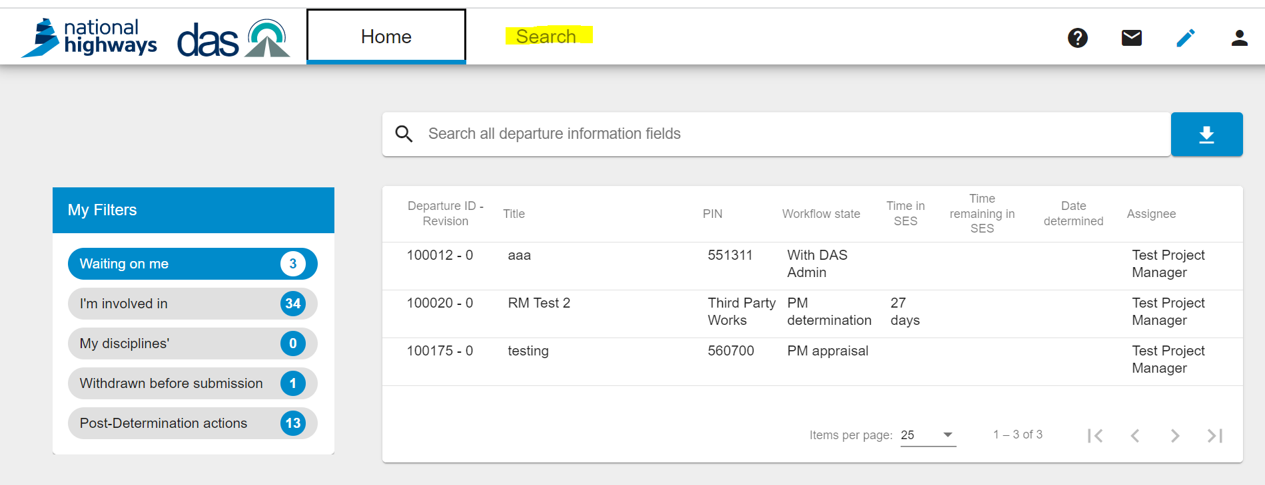
From your Home page click on the top search button

Slide 7
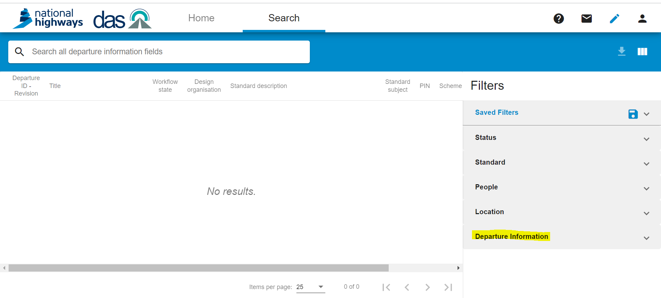
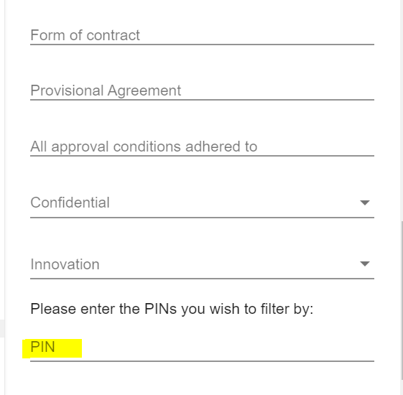
From the filters on the right-hand side select “Departure Information” and scroll down until you find “PIN” enter your PIN(s) details and return.

Slide 8
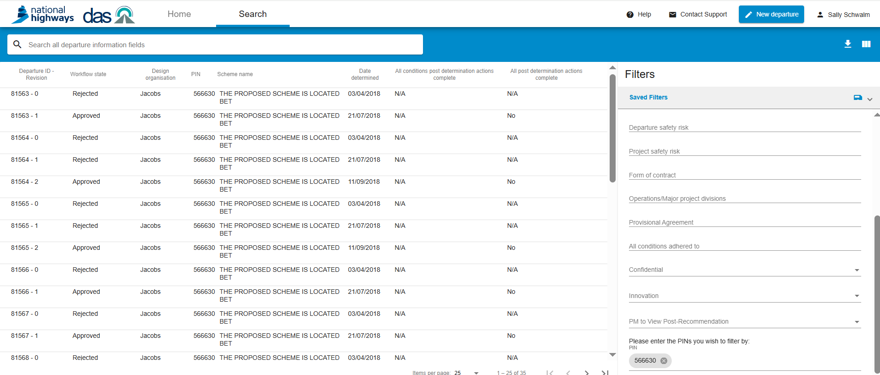
To ensure that the report is displaying the information you require, click on the column selection box here.
A list of departures will then appear on your screen

Slide 9
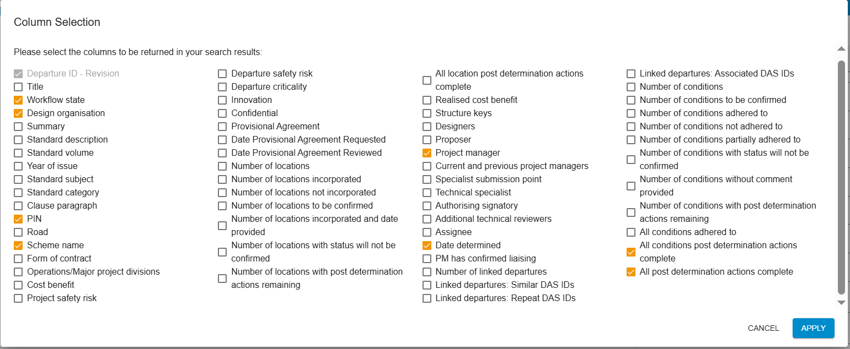
Select the columns that you would like to see on your report. We recommend the columns ticked below for your Post Determination report.

Slide 10
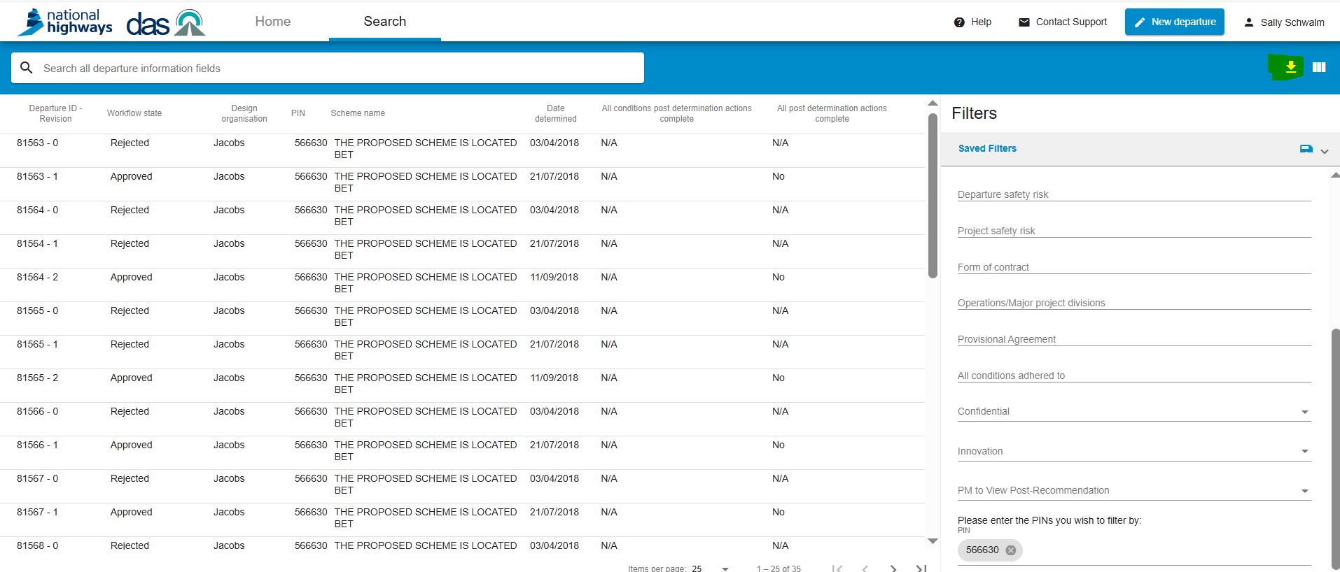
Now download your report by clicking on the down arrow here. Please be aware that this will produce a csv report so you will need to convert this to Excel to save your changes.

Slide 11
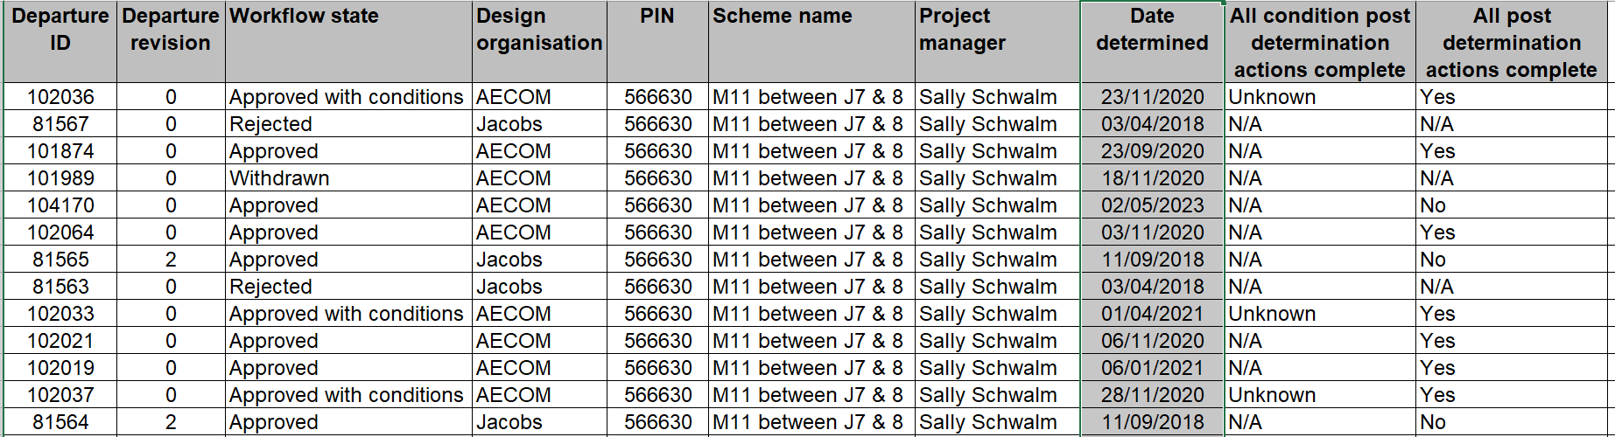
This is the raw data that you will receive, and this is a good example of a scheme that covers both DAS 2 and DAS 3 Departures
Sort Departure ID smallest to largest
Filter the workflow state by removing any Rejected, Withdrawn and any departures that are not determined.

Slide 12
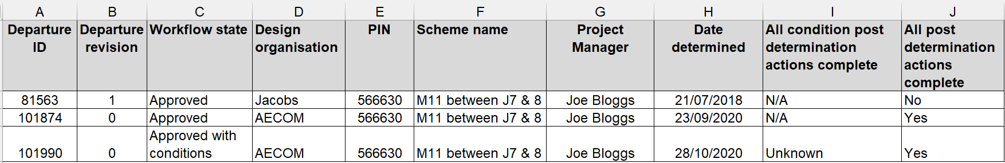
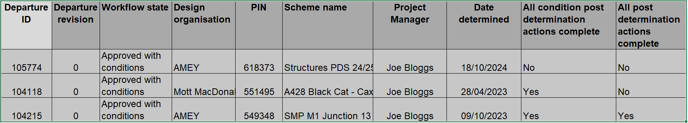
This report produces a full list of your departures and provides clarification on which departures you have closed out at Post Determination and those still requiring action.
This date will dictate which process you need to follow for performing Post Determination on your departures on DAS. See link for Guidance Post Determination and the following slide.
Workflow State (Column C) | All condition Post Determination Action complete (Column I) | All Post Determination Actions Complete (Column J) | Explanation
Approved | N/A | No | Departure has no conditions set by SES but will need to be reviewed by PM to ensure all Post Determination (PD) fields are complete.
Approved with Conditions | Unknown | Yes | This Departure was submitted prior to the DAS enhancement of Condition Management. You will need to review the departure to ensure that conditions have been met and evidence attached. All other areas of Post Determination stage have been completed. The status will remain as “Unknown”.
Approved with Conditions | No | No | This departure was entered after the enhancement of Condition Management and evidence that the condition has been met has not been entered onto DAS. Other areas of PD stage also need completing.
Approved with Conditions | Yes | Yes | This departure was entered after the enhanced Condition Management and evidence that the condition has been met has been entered onto DAS and all areas of PD have been completed.
Key to Understanding Column I and J

Slide 13
How to Process your Departure at Post Determination

Slide 14
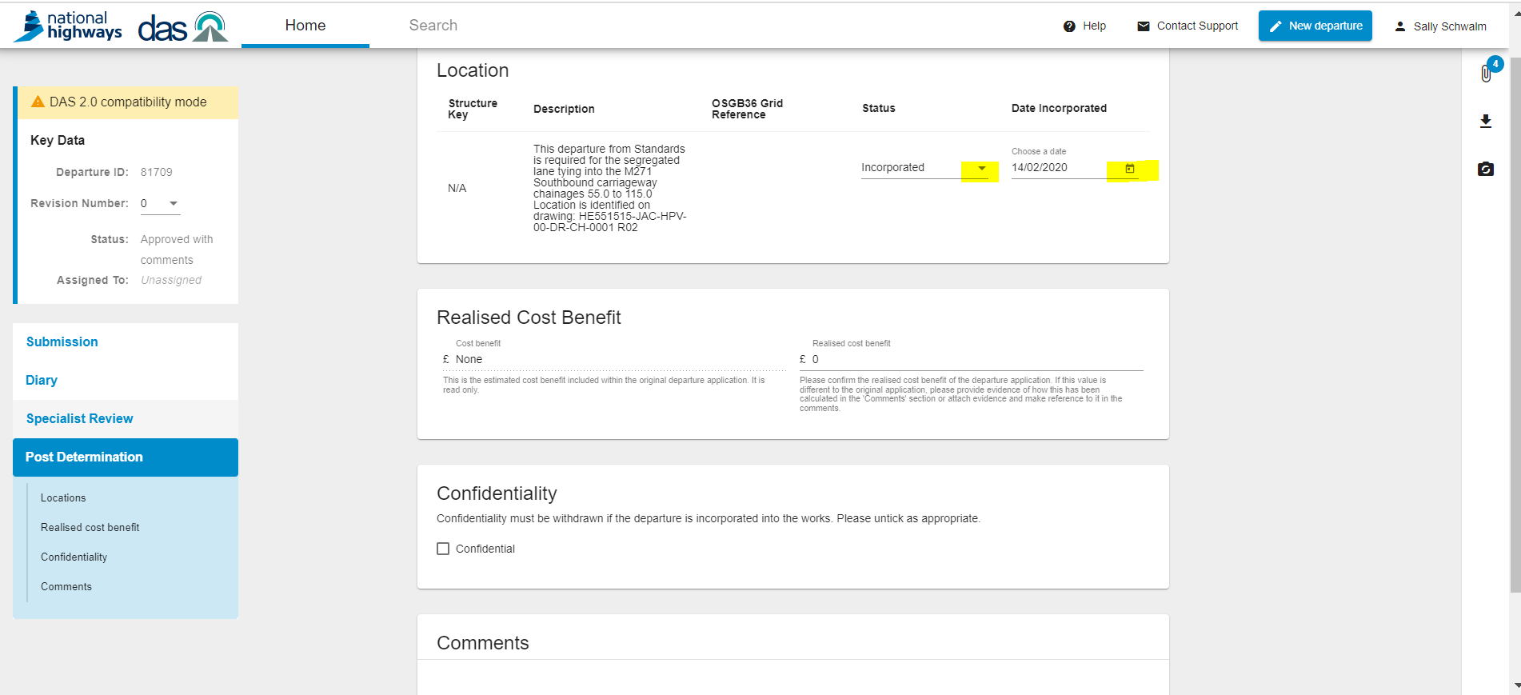
Departures Created or Determined before the 31 March 2020 inclusive
The PM needs to only update the status (incorporated/not incorporated) and the date for incorporation which could be the date that the scheme opened to traffic.
Although a value is not required against the ‘Realised Cost Benefit’ please add a zero to close the departure down fully.
The information about whether a departure was incorporated should be in the scheme’s ‘Departures from Standards Checklist’ PCF product, in the H&S file and other relevant design documentation provided by the Designer at handover.
Although a value is not required here – please add a zero to fully close-down the departure at Post Determination

Slide 15
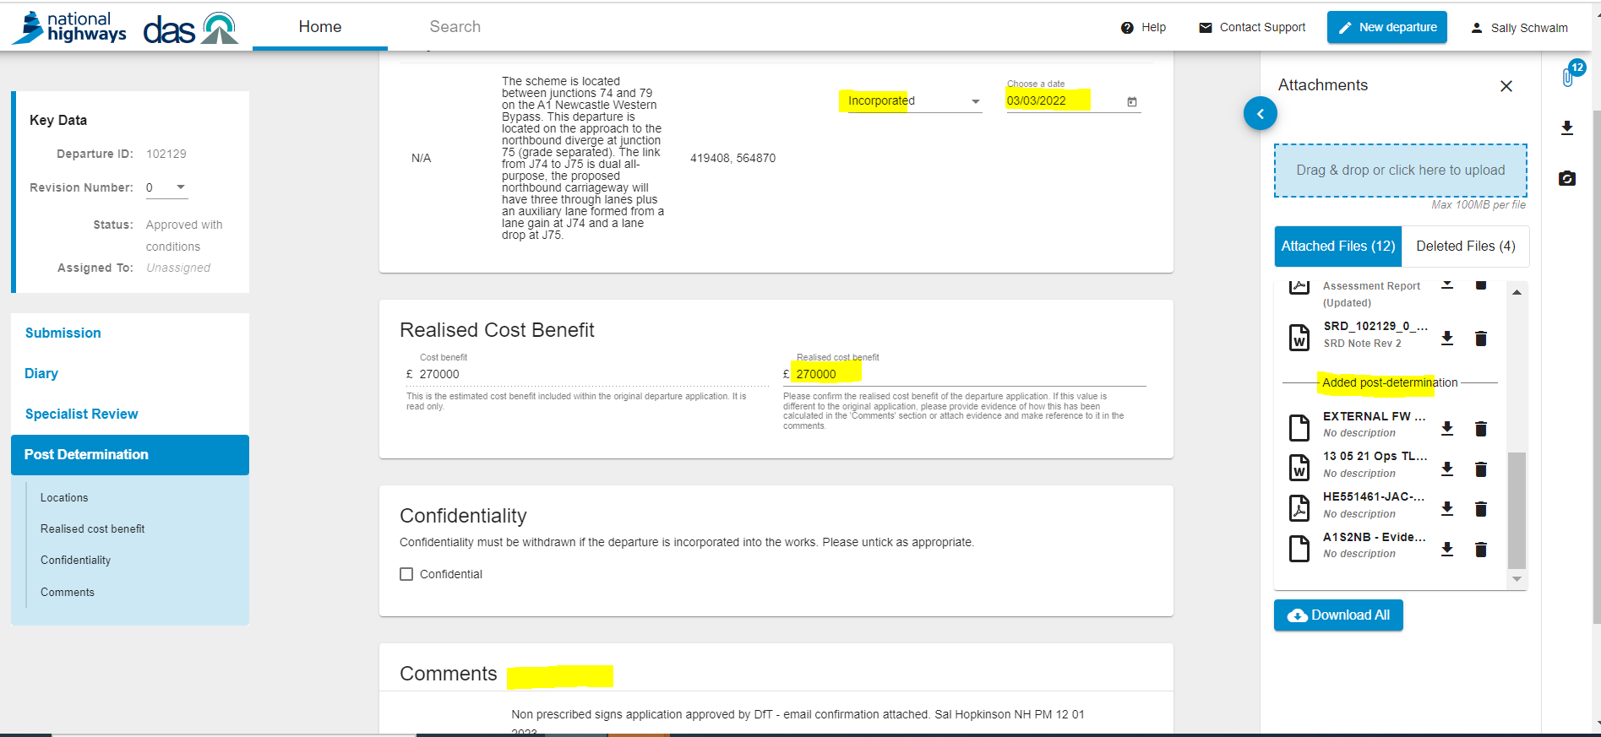
Departures Determined on or after 01 April 2020 but before 5th May 2022
The PM needs to update the status (incorporated/not incorporated) and the date for incorporation which could be the date that the scheme opened to traffic.
Add the ‘Realised Cost Benefit’. If the departure was not incorporated into works, then the realised cost benefit shall be zero.
Untick the ‘Confidentiality’ checkbox as appropriate.
If the Departure was approved with conditions, confirm whether each condition was adhered to in the comment section and attach any relevant documentation as evidence using the attachments feature.

Slide 16
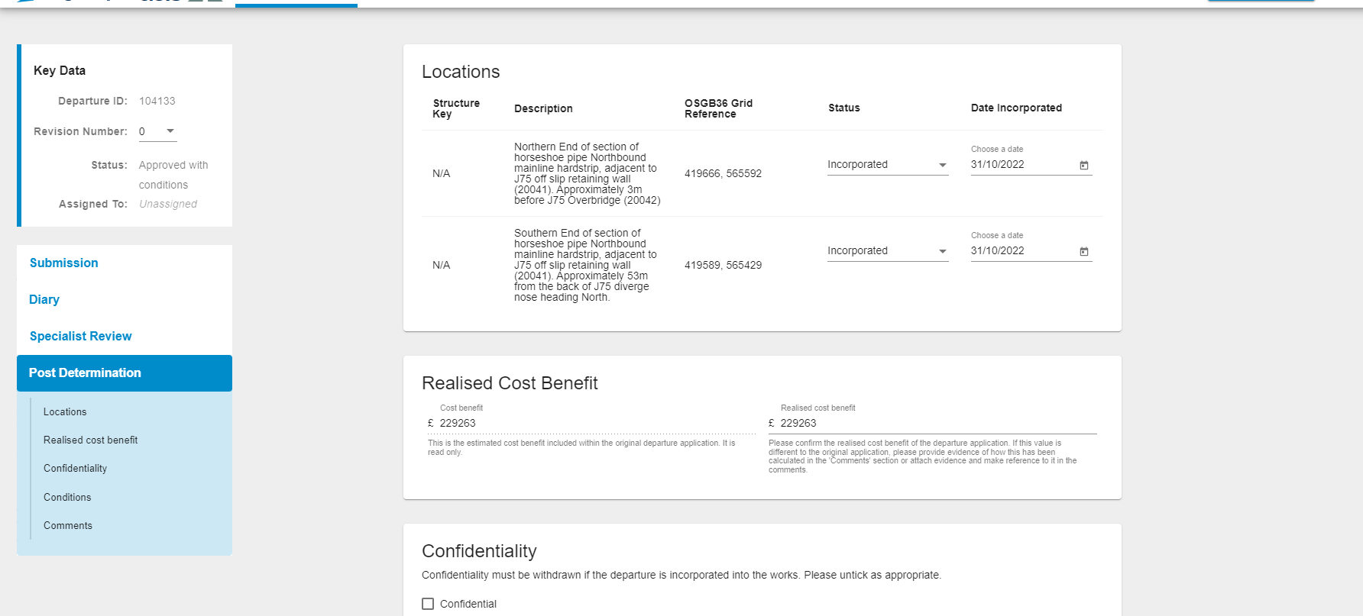
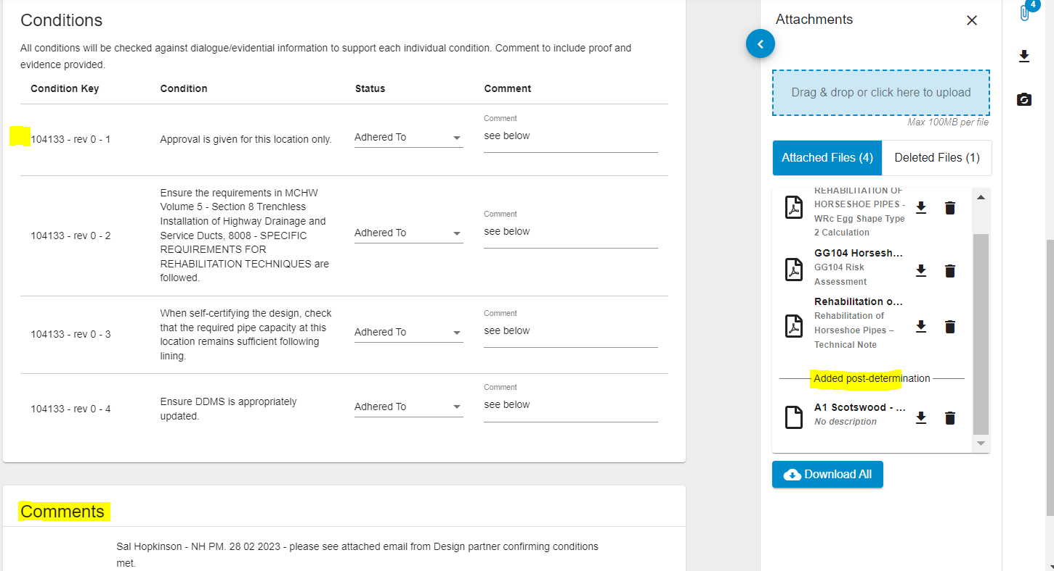
Departures Determined after 5th May 2022
The PM needs to update the status (incorporated/not incorporated) and the date for incorporation which could be the date that the scheme opened to traffic.
Add the ‘Realised Cost Benefit’. If the departure was not incorporated into works, then the realised cost benefit shall be zero.
Untick the ‘Confidentiality’ checkbox as appropriate.
If the Departure was approved with conditions, confirm whether each condition was adhered to and attach any relevant documentation as evidence using the attachments feature. The comments field against each condition should be used to outline any evidence provided and other relevant information. Any further information regarding the adherence of conditions can be added to the comment section as shown below.

Slide 17
Guidance on Post Determination

Slide 18
FAQs
When should Post Determination be done?
The NH PM only needs to complete the Post Determination stage when the relevant departure has been physically incorporated into the Works as a departure in a completed design may still change in construction i.e., all departures should be closed out (i.e., Post Determination stage) by the end of Stage 6 of the project lifecycle.
2. Should the PM work with the Design lead to gather evidence required for the Post Determination at regular intervals during the design phase?
The NH PM should work closely at regular intervals with their designers regarding adherence to conditions set by SES, its evidence, and the Realised cost benefit.
3. What advice would you give to NH PMs taking over a scheme where departures have been assigned to previous NH PMs?
It is incumbent on the new NH PM taking over the scheme to let the DAS team know so that all departures that require closing out at Post Determination stage is bulk transferred to them.
4. What would the NH PM need to do regarding departures yet to be closed out at Post determination where the applicant for that departure is no longer in contract.
The handover notes from one Designer to another should include the Departures from Standards Checklist which then should identify details regarding conditions adherence etc… It is incumbent on the new Designer to review all departures and make sure they have all the details to run with them.

Slide 19

Post Determination Stage Guidance and Help
Departures Manual
  Section 2 – Paragraphs 2.8 and 2.9
  Section 3. Process Review - Phase 8 (Post Determination)
  Section 6. Project Governance for Departures – Post Determination (Paragraphs 6.17 to 6.21)
  DAS Help
    Post 5th May 2022 use the guidance in DAS Help i.e. “Using DAS” dropdown and then choosing “Post Determination” – see link below:
  https://das-help.highwaysengland.co.uk/post-determination/
  Further FAQ’S on Post Determination on DAS Help
    https://das-help.highwaysengland.co.uk/faqs/#Post-Determination

Slide 20
Thank you
Thank you for watching this Departures training video for National Highways Project Managers
Any links referred to in the video can be accessed in the accompanying PowerPoint slide deck published underneath the training video
Please bookmark the Departures Manual and help pages: https://departures.highwaysengland.co.uk/
Further assistance is available from departures@nationalhighways.co.uk

