Slide 1
DMRB consequential amendments
Workshop with authoring community
Mariapia Angelino, WSP
Kate Albon, National Highways
Simon Hartshorne, National Highways
28.11.2023

Slide 2
Objectives of today
Present what we are trying to achieve from a final user / designer perspective
Share the approach for drafting DMRB consequential amendments, including examples of good practice
Share programme dates for DMRB consequential amendments
Clarify governance deliverables to be produced
Collect questions from the audience
Use Teams chat box.
We may not be able to answer all questions during this session due to time constraints, will share FAQ afterwards.

Slide 3
Outcome of today
Understand the necessity of establishing clear links between DMRB, IfS and WSR
Understand the high-level principles for drafting DMRB consequential amendments
Understand the specific drafting rules for drafting DMRB consequential amendments.
Know key deadlines for finalising the documents, including governance deliverables.
Be ready to update the DMRB documents following the rules presented today.

Slide 4

Winter travel by public transport
Immediately before travel, check the following:
• Weather forecasts and warnings
• Public transport operator/ organisation websites/apps etc (ScotRail, National Rail, Trainline, LNER etc)
• Contact colleagues, clients and third parties about travel and weather conditions at your destination
• If at all in doubt, ‘do not proceed’
Plan for what could go wrong
• Firstly, do you need to travel? Can the journey be avoided by holding meetings via MS Teams etc.
• If you do need to travel, plan your route, schedule and book your tickets well in advance. Check times of last buses/trains so you don't get stranded
• If you are travelling alone, assign a travel buddy so someone always knows where you are and can raise the alarm if you do not check-in.
What would you do if you missed the last bus/train
• How would you keep safe, arrange overnight accommodation/onward travel etc?
• What contact information might you need to take with you?
• What would you need if you found yourself stranded overnight e.g. extra prescription medication, mobile phone charger, extra change of clothes, toiletries etc?
Notes:
Public transportation often faces sudden delays or cancellations, particularly during the winter season, posing additional challenges, especially when travelling in darker hours. As a result, staying informed about potential delays and having contingency plans in place become essential strategies for commuters during these challenging times.

Slide 5
What we are trying to achieve from a final user / designer perspective

Slide 6
What we are trying to achieve from a final user / designer perspective
Providing clear requirements and advice for where the designer has a choice to make.
Where there is a design decision to be made, we want to clarify how we expect our supply chain to make that decision to meet our requirements for the outcome that we want.
Inform how the designer sets values, classes, levels etc. appropriate to the design outcome.
Providing requirements and advice which apply to designers in general regardless who assumes this role by focusing on design outcomes rather than contractual arrangements.
I.e. it does not matter if it is contractor or third-party design.
Establishing clear links between:
National and EU standards → DMRB → Design decisions (not roles) → Design outputs → IFS → WSR
The ultimate goal is to achieve a thread of information running through our documents using consistent topics and terminology, including our criteria for the design decisions and the communication of those decisions to the constructor.

Slide 7
What we do not want
A list that just repeats the specifier instructions
A list that just repeats sections of external standards, e.g. Annex ZAs
References to specific WSRs, which may change
No advice on how to make a design decision
No criteria for design outcomes

Slide 8
Manual for Development of Documents
The drafting rules in MDD Part 3, v.6.4 shall apply.

Slide 9
Specific drafting rules

Slide 10
Specific drafting rules
Verb forms
Consistent topics and terminology
Redrafting of advisory text
Clause neutrality
Cross references
Clarity of design outputs
Performance and method requirements
Document location based on the audience

Slide 11
1. Verb forms
Two verb forms for requirements: must / shall
Three verb forms for advice: should / may / can
Advice always relates to a requirement
Avoid implicit requirements phrased as advice
Hidden requirements such as “is required to”, “are needed to” “are necessary for”

Slide 12
2. Consistent topics and terminology
Same terminology has to be used when referring to same topics.
This supports consistency and makes text clear and unambiguous, as well as linking WSRs and design outputs.
This applies at all levels within a document:
Section titles
Headings and sub-heading
Requirements, advice and notes
This applies across related DMRB and MCHW documents
This applies both internally and when referencing a third party (BSI) standards.

Slide 13

Example of consistent topics and terminology
Example
IfS
CC 204 High friction surfacing General requirements for high friction surfacing 1.1 High friction surfacing (HFS) shall be installed in the locations detailed in WSR 204/001.
SI.1.1a-e location stuff
SI.1.1f Complete field 'Product application', of type multi-select list, selecting from options Cold applied HFS, Hot applied HFS, to define the application of HFS.
SI.1.1g Complete field 'HFS performance designation', of type single-select list, selecting from options A, B, C, to define the performance designation of the HFS.
CD 236 NAA(E)
E/3. Design outputs for surface treatments High friction surfacing E/3.1 The product application shall be selected from one or more of the following: cold applied HFS; and hot applied HFS.
NOTE The product application can affect the service life of the material.
E/3.2 The HFS performance designation shall be selected in accordance with BS 8870 [Ref 6.N]
BS 8870 The hierarchy of performance designations shall be such that, in accordance with Table 5: a) A forms the minimum; b) B is more onerous than A; and c) C is more onerous than B. A product satisfying a specific performance designation shall be accepted for use on sites with a less onerous performance designation. Table 5 — Performance designation for combination of traffic and site categories
DMRB
BSI standard

Slide 14
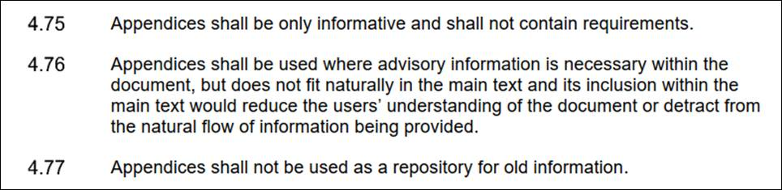
3. Redrafting of advisory text
Assess whether it is advice or hidden requirements.
Hidden requirements such as “is required to”, “are needed to”, “are necessary for”.
Check whether advice should go in the main text or in an appendix.
Main text if short / limited clauses.
Appendices if longer – see MDD rules. Note that appendices cannot contain requirements nor should become a repository of old information.
Remove obsolete content, redraft content that is still valid following MDD rules.

Slide 15
4. Clause neutrality
The DMRB shall not assume that a task will be carried out by a specific third party – DMRB design documents apply to “designers” in general.
DMRB do not prescribe procedures or ascribe organisational or personnel roles, functions or responsibilities unless imperative for the document under consideration (for example when introducing specific roles clearly defined in the document).
There should not be a differentiation between a principal designer, a specialist designer or a contractor carrying out the role of designer. The DMRB is written to produce design outputs that inform the WSR and the works.
We need to enable document usage under differing types of contracts and procurement used by the Overseeing Organisations.
We need to support consistency in terminology across DMRB documents (e.g. technical approval authority / checkers)
Notes:
One of the risks of using a personnel-function approach is that others in the supply chain consider they can ignore the action with obvious risks for the quality of deliverables.

Slide 16
Examples of clause neutrality
Example
1.1 For each gabion wall for earthworks the design output identified in Section X of this document shall include:
Gabion structure reference;
Drawing or model ID;
Drawing or model title;
Minimum working life;
​If Contractor design is required or not.
2.1 Designers and contract specifiers should seek early engagement with asphalt suppliers and contractors regarding the available WMA products and their suitability on a scheme specific basis.
Not the designer’s decision as to the form of further contracts.
The role of specifier will never involve engagement with third parties.

Slide 17
5. Cross references (1/2)
Do not make direct reference to WSRs.
Introduce a standard statement in the Foreword at document level.
3.3 The TASCAR design proposals shall include all details necessary:
for the construction of TASCAR in accordance with CC 133 [Ref 1.N]; and
to meet the works specific requirements (WSR) for the scheme.
Foreword
Publishing information
This document is published by National Highways.
This document supersedes BD 100/16, BA 57/01, BD 57/01 and IAN 124/11 which are withdrawn.
This document provides requirements and advice used to develop the design outputs required to deliver the works in accordance with CC 483 (Structural steelwork), CC 482 (Structural concrete), etc.
Tail wagging the dog. WSR does not form part of the design brief.

Slide 18
5. Cross references (2/2)
Manage design outputs relevant to several DMRB documents.
CD 354 Design of minor structures will cover design outputs for all minor structures including column height, bracket projection etc.
This design outputs are also relevant to TD 501 Road lighting design.
TD 501 shall include a clause ‘The lighting design outputs for lighting columns shall be provided in accordance with Section X of CD 354’

Slide 19
6. Clarity of design outputs
Design outputs have to be specific, measurable, achievable, unambiguous, contractually sound.
Avoid ambiguous phrases (“consideration given to…”, “appropriate”). See list of vague terms to avoid in MDD Part 3, Table 2.
Design outputs have to support achievement of the end result by presenting clear flow of information.
Text covering outcomes, outputs, options and criteria – not just lists of SIs. [post meeting edit]
Notes:
Orphaned requirements WSR entries for which there are no design requirements / or guidance where the choices are recommended

Slide 20
Example of ambiguous requirements
Example
2.6 The lighting design shall be developed to support Net Zero targets and meet circular economy requirements.
2.3 The design outputs for the limits for the contaminant concentrations in earthworks materials shall include:
the unique reference to identify the location of the contaminant;
the unique reference to identify the contaminant reference;
the minimum concentration of contaminant in a material to classify the material as unacceptable;
the type of test required to determine the contamination concentration in the material and the standard the test is to be undertaken in accordance with;
the frequency of testing required to determine the contamination concentration in the material.
No references to net zero targets or circular economy requirements.
None of this includes advice to the designer. There is no way to control the designer contractually if inappropriate values or test are selected.

Slide 21
Example of presentation of flow of information
Example
IfS
CC 204 High friction surfacing General requirements for high friction surfacing 1.1 High friction surfacing (HFS) shall be installed in the locations detailed in WSR 204/001.
SI.1.1a-e location stuff
SI.1.1f Complete field 'Product application', of type multi-select list, selecting from options Cold applied HFS, Hot applied HFS, to define the application of HFS.
SI.1.1g Complete field 'HFS performance designation', of type single-select list, selecting from options A, B, C, to define the performance designation of the HFS.
CD 236 NAA(E)
E/3. Design outputs for surface treatments High friction surfacing E/3.1 The product application shall be selected from one or more of the following: cold applied HFS; and, hot applied HFS.
NOTE The product application can affect the service life of the material.
E/3.2 The HFS performance designation shall be selected in accordance with BS 8870 [Ref 6.N]
BS 8870 The hierarchy of performance designations shall be such that, in accordance with Table 5: a) A forms the minimum; b) B is more onerous than A; and c) C is more onerous than B. A product satisfying a specific performance designation shall be accepted for use on sites with a less onerous performance designation. Table 5 — Performance designation for combination of traffic and site categories
DMRB
BSI standard

Slide 22
Example of presentation of flow of information
Some verification / documentation requirements specified in SIs relay on the specifier to working out contract specific compliance testing required.
This is not for the specifier to ‘guess’, rather advice should be provided in the DMRB on what is expected to minimise risks.

Slide 23
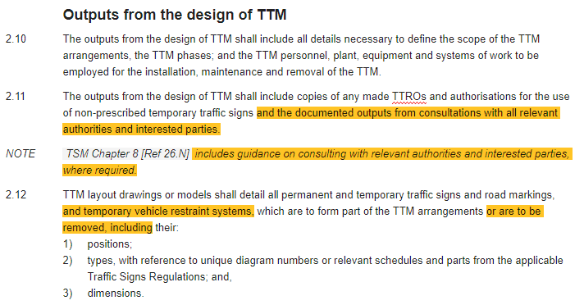
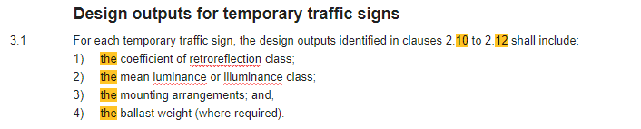
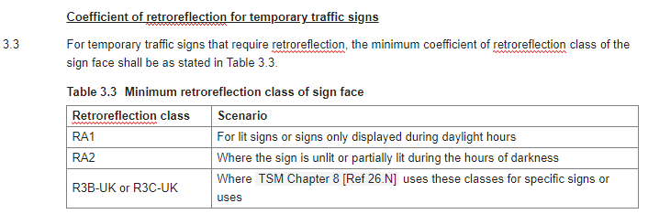
Text – not just lists
Example
STEP 1: High level design outcomes
STEP 2: Specific design outputs / characteristics
STEP 3: Presentation of options / criteria
STEP 4: Explanation of how to make a choice

Slide 24
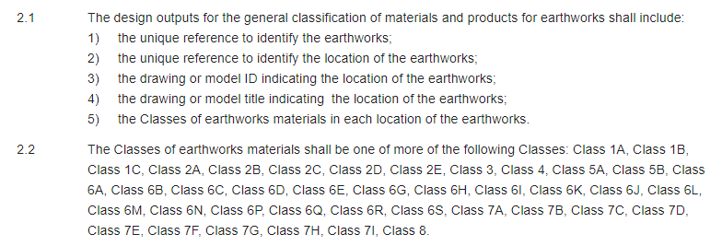
Text – not just lists
Example
STEP 1: High level design outcomes
Unclear what the final outcomes are.
This could be covered in another document, therefore reference should be explicitely made to that document to provide complete, clear and unambiguous information.
STEP 2: Specific design outputs / characteristics
STEP 3: Presentation of options / criteria
STEP 4: Explanation of how to make a choice
Unclear how to make a choice.
This would leave a gap and designers wouldn’t know what criteria are for achieving the final outcomes.

Slide 25
7. Performance and method requirements
Refer to MDD Part 3, section 12 and Annex 3B on the «mixed» performance-based approach.

Slide 26
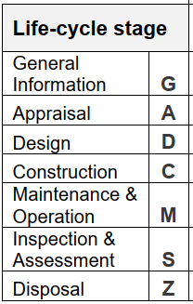
8. Document location based on the audience
To choose the appropriate document to move content, consider the audience.

Slide 27
Specific drafting rules
In this session we have covered:
Verb forms
Consistent topics and terminology
Redrafting of advisory text
Clause neutrality
Cross references
Clarity of design outputs
Performance and method requirements
Document location based on the audience
Please undertake a final consistency check between DMRB and MCHW

Slide 28
Key programme dates for DMRB consequential amendments

Slide 29
Key programme dates
end of | Drafting and finalisation of governance deliverables | end of Jan 2024
end of | Content specialists (CS) pre-consultation review | end of Feb 2024
end of | Addressing comments from CS pre-consultation review | mid March 2024
end of | Consultation | mid April 2024
end of | Comment resolution | mid May 2024
end of | Quality review | end of May 2024
end of | Technical authors addressing comments from quality review | mid June 2024
end of | Pre-check CIAT | end of June 2024
end of | Commercial review | end of July 2024
end of | TSC chair ratification | end of August 2024
end of | DD approval | end of September 2024
end of | HoS approval | end of October 2024
end of | CHE Authorisations | end of November 2024

Slide 30
Governance deliverables to be produced

Slide 31
Governance deliverables
CARS document
Clause change summary (existing DMRB documents)
Background commentary (new DMRB documents)
Impact assessment report, including commercial impact assessment template (CIAT)
Consultation report
High level narrative document (for approvers and authorisers)

Slide 32
Support provided

Slide 33
DMRB Support provided
Weekly drop-in sessions on Tuesday (now covering consequential amendments too)
Content specialists’ Quality Reviews
Automated checks incorporated into CARS
Content reviewers assigned to specific documents to streamline delivery of compliant documents
CIAT pre-checks
MCHW & DMRB Programme Management
Teams Channels
DMRB and MCHW training materials and governance team
TSC chairs and secretaries knowledge sharing channel
To support authoring teams and help manage workload
To share updates
33

Slide 34
Outcome of today
Understand the necessity of establishing clear links between DMRB, IfS and WSR
Understand the high-level principles for drafting DMRB consequential amendments
Understand the specific drafting rules for drafting DMRB consequential amendments.
Know key deadlines for finalising the documents, including governance deliverables.
Be ready to update the DMRB documents following the rules presented today.

Slide 35

Menti
https://www.menti.com/blnd1gxt3dks
www.menti.com
Code: 9717 4812

Slide 36
Q&A

Slide 37
Thank you for your attention

