Slide 1

Digital MCHW Training on the Document Development Plan (DDP) Mariapia Angelino, WSP Rebecca Axtell, Highways England November 2020

Slide 2
Objectives of this session
Provide training on the production of the Document Development Plan (DDP) relevant to the MCHW documents
Answer any questions from the audience.
This is not training for authoring – separate sessions will be delivered in March 2021. However, some key changes and drafting aspects will be presented today as they are necessary to draft the DDP.
Notes:
Please post any questions in the chat box during the presentation.
Due to time constraints, we may not be able to answer all questions but we will prepare and share a FAQ following this presentation.

Slide 3
Agenda
Introduction
Document Development Plan (DDP) template
What you need to know to plan your documents
Closing remarks

Slide 4
Introduction 1. Why we will be updating the MCHW 2. Consultation with stakeholders and recommendations 3. Vision and practical implications 4. Work programme
Notes:
Good morning all, this is Becky Axtell from Highways England. In this sessions I’ll cover…

Slide 5
Why we will be updating the MCHW
It is part of Highways England’s business strategy.
Jim O'Sullivan and Mike Wilson have both described it as 'good business' and something we should be doing as business as usual building upon the success of the DMRB update.
Notes:
The DMRB review is widely considered a huge success for Highways England. Many of you here today have been involved in the work – and we really want to thank you for your contribution. We naturally want to build upon the success of the programme and take that onto the MCHW review.
This work is part of …

Slide 6
Other key drivers for change
Age and inconsistent format
Making it easier to keep content up to date
Unclear distinction between construction and design requirements
Alignment between the new DMRB and MCHW can be improved
Our contracts and our relationship with our supply chain are continuing to evolve
To be digital ready – enhanced compatibility with BIM / support to our vision for digital roads
Wider changes in design and construction methods affecting how construction works are specified
Notes:
In addition to that, there are other key drivers for change.
The age and format varies across the suite of the documents, we want consistency to help usability and we want our construction requirements to be up to date where they are not.
We want to make the content easier to maintain and keep up to date
We want to clarify the distinction between construction and design requirements. The MCHW currently contains both construction and design requirements, particularly in Volume 2, and we want design requirements to be in the DMRB.
We need to better align our construction requirements with our new design requirements as a result of the DMRB refresh.
We want to enable flexibility of contracting, considering that our contracts and our relationship with our supply chain are continuing to evolve, The use of ICE’s Engineering and Construction Contract has been largely replaced by the NEC. There are many different contract types and we need to make sure our construction requirements work with them.
We also want the future MCHW to be digital ready. The current MCHW is designed to be paper based and to work with paper-based drawings. We need to make it work better with BIM. There is also a huge opportunity to support our vision for digital roads as part of the MCHW update.
There are wider changes in design and construction methods affecting how construction works are specified. More automation, more off-site and more intelligence based construction methods. We want a future MCHW that does not inhibit this to happen.

Slide 7
Consultation with key stakeholders
Conducted over 5 months in 2018
106 responses were received from 67 organisations
Notes:
In 2018 we also conducted a wide consultation with stakeholders across the entire UK construction industry. We collected 106 responses from 67 organisations including contractors, design organisations, product manufactures, other transport organisations, software developers. As a result of that we developed one high level recommendation presented on the next slide…

Slide 8
High-level recommendation
The MCHW should be updated to enhance its
usability, structure, content and
applicability for modern contract forms and construction
Notes:
“The MCHW should be updated to enhance its usability, structure, content and applicability for modern contract forms and construction”
This recommendation summarises 15 specific recommendations presented on the next slide…

Slide 9
The future MCHW will…
…continue to set out the requirements to be used for the United Kingdom motorway and all-purpose trunk road network.
…be compatible with the future DMRB.
…have content related to conditions of contract removed.
…be and remain up-to-date.
…clearly define requirements to be fulfilled by constructors.
…will provide clear and easier to use instructions to contract compilers.
…enable national variation of MCHW clauses by Devolved Administrations or Highways England by introducing clauses in the main text.
…have a consistent style and format, and be intuitive to use.
…be future-proofed for advances in information technology.
…be compatible with future asset information strategies and digital design, construction, operation and maintenance of roads.
…seek to implement more content developed in partnership with others and to refer to content published by other reputable bodies.
…not inhibit and will seek to support trends in construction.
…be contract neutral and compatible with conditions of contract used by Devolved Administrations and Highways England.
The timing of work on the update of the future MCHW will not overlap work on the DMRB update, whilst seeking to achieve efficiencies available from continuity of resourcing.
Create a community of document owners, supported by content specialists, to strengthen collective commitment to programme, derive efficiencies and ensure high quality drafting.
PURPOSE, SCOPE AND CONTENT
FORMAT
ENABLING FUTURE (LONGER TERM) EFFICIENCIES
PROGRAMME DELIVERY
Notes:
I’ll not go through all of the recommendations, just wanted to flag that we identified recommendations about
PURPOSE, SCOPE AND CONTENT
FORMAT
ENABLING FUTURE (LONGER TERM) EFFICIENCIES
PROGRAMME DELIVERY
Importantly, these recommendations have some fundamental practical implications which I will present in a second…

Slide 10
Vision
The future MCHW will provide clear and unambiguous requirements and instructions, compatible with modern contract forms and future construction practices
Notes:
To drive the future MCHW, we have defined a vision statement shown on this slide:
“The future MCHW will provide clear and unambiguous requirements and instructions, compatible with modern contract forms and future construction practices”
This statement covers:
clarity of requirements for constructors and instructions for specifiers; this in turn will enable innovation by being clear about requirements and not unduly prescriptive
compatibility with modern contract forms, contract neutrality, etc.
compatibility with future construction practices, which include decarbonization, customer focus, digitalisation, off-site construction, etc. Off-site construction is increasingly being talked about in the highway context and one of the current barriers is seen as lack of digital communications between design, factory, and site in relation to requirements. As we face the crisis of climate change, decarbonisation is one of our top priorities as a business – we need to make sure our construction requirements are future ready and ready to lead the movement in this direction. We’ll provide more details on that during the training sessions for authoring.

Slide 11
Practical implications
MCHW developed and hosted digitally enabling machine readability
Volumes 1 and 2 fully updated and with a new look - new drafting rules to develop clear requirements for constructors and instructions for specifiers
Volume 3 fully updated and BIM compatible
Volume 5 removed, relevant content moved to Volumes 1, 2, 4
Volume 6 removed, relevant content moved to DMRB and H&S docs
Conditions of contract content removed – clauses to be contract neutral
Introduction of nationally determined requirements / sections
MCHW and DMRB to be fully compatible
Notes:
There are 8 practical implications of this work:
(…)

Slide 12
Key benefits
Greater efficiency in project delivery
Greater efficiency in the production of contract documentation
Greater efficiency in the production and maintenance of the MCHW
Fewer compensation events
Fewer Departures from Standards
Improved construction quality
Enhanced innovation
Notes:
Key benefits from this work are:
(…)

Slide 13
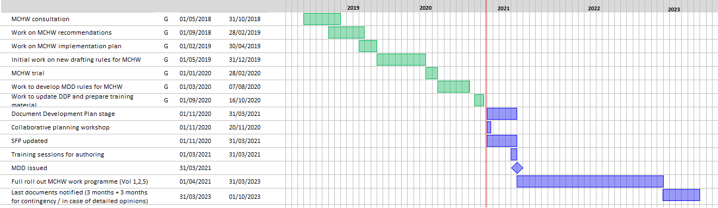
Work programme
Today
Notes:
In terms of work programme, this slide shows the work done since May 2018. Next steps are:
Document development planning stage (…)

Slide 14
Interim changes to MCHW
Q. What if you want to make a change to your document(s) prior to 2024 (when all documents are expected to be published)? For example due to:
a technical update
industry or supply chain feedback
changes in national legislation
changes to external standards
A. TAGG are developing criteria by which changes / amendments will be accepted to current documents. The MCHW needs to work contractually for the next three years. For any specific query, please speak to TAGG.

Slide 15
Document Development Plan Template
Notes:
Thank you Becky. In this session I’ll be covering the Document Development Plan Template

Slide 16
Importance of the DDP
The document development plan is a key deliverable.
It aims at defining the criteria by which the final document is considered a success and helps mitigate the risk of significant rework in subsequent stages of the drafting process due to the lack of clear understanding of the document’s needs.
The DDP will be notified to all consultees once ready.
Please involve key parties in DDP work, particularly the Devolved Administrations.
Notes:
It aims at defining the criteria by which the final document is considered a success, including its structure, specific content, key stakeholders to be consulted or kept informed, links to other Highways England’s document sets.
The importance of developing a detailed and well-thought DDP emerged from the DMRB work programme. Discussing and agreeing the DDP helps mitigate the risk of significant rework in subsequent stages of the drafting process due to the lack of clear understanding of the document’s needs.
Please make sure that all relevant parties are involved at the outset. DAs are key stakeholders in this work, make sure engagement is done upfront and they are involved as part of the DDP development. They will also be notified once the DDP is ready.

Slide 17
DDP: key aspects to be addressed
 | Section in the DDP template
1 | Key dates for document development
2 | Production team
3 | Deliverables
4 | Summary of drafting needs and approach
5 | Interfaces with other documents and coordination required
6 | High-level section review
7 | Proposed outline document structure
8 | Risks and opportunities
Notes:
The DDP is made up of 8 sections …

Slide 18
DDP: key aspects to be addressed
 | Section in the DDP template | What you need to know
1 | Key dates for document development | Jira milestones
2 | Production team | Key names / contacts
3 | Deliverables | Relevant when the drafting process will start
4 | Summary of drafting needs and approach | New content structure and presentation of the MCHW Consequential updates to the DMRB Sections to be entirely updated and restructured following specific rules Consequential updates to drawings in Volume 3 Identification of national variations
5 | Interfaces with other documents and coordination required
6 | High-level section review
7 | Proposed outline document structure
8 | Risks and opportunities
Notes:
While the first 2 sections are straightforward to complete, and the third one is relevant when the drafting process will start, for the others you need to be familiar with some key changes and drafting principles that will underpin the future MCHW. These are: (…)
In the next section I’ll drill into each of these 5 items a bit further.

Slide 19
What you need to know to plan your documents
Notes:
This session is the main one of this training and I’m sure it will raise questions. Please post any queries in the chat box during the presentation and we’ll try to answer them at the end, in any case within a FAQ that will be shared soon.

Slide 20
Summary
Content, structure and presentation of the MCHW will change.
DMRB documents may need to be updated (or new documents created) to provide design information currently within the MCHW.
Sections need to be entirely restructured following specific rules.
Changes to drawings in Volume 3 may be needed to implement the specification requirements
National variations have to be identified.
Notes:
We’ll drill into each of these a bit further.

Slide 21
Summary
Content, structure and presentation of the MCHW will change.
DMRB documents may need to be updated (or new documents created) to provide design information currently within the MCHW.
Sections need to be entirely restructured following specific rules.
Changes to drawings in Volume 3 may be needed to implement the specification requirements
National variations have to be identified.

Slide 22
Current MCHW
Volume 0
Manual Contract Document for Major Works and Implementation Requirements
Volume 1
Specification for Highways Works
Volume 2
Notes for guidance
Volume 3
Highway Construction Details
Volume 4
Bill of quantities
Volume 5
Contract Documents for Specialist Activities
Volume 6
Requirements and advice relating to H&S legislation

Slide 23
Current MCHW
Volume 0
Manual Contract Document for Major Works and Implementation Requirements
Volume 1
Specification for Highways Works
Volume 2
Notes for guidance
Volume 3
Highway Construction Details
Volume 4
Bill of quantities
Volume 5
Contract Documents for Specialist Activities
Volume 6
Requirements and advice relating to H&S legislation
H&S documents
DMRB design row
Future MCHW
Introductory documents
Specification for Highways Works (SHW) documents
Instructions for Specifier (IfS) documents
Standard Drawings
Bill of quantities
Core Requirements
Core Instructions
Nationally determined requirements / sections
Nationally determined requirements / sections
Sample appendices
Notes:
The future MCHW will be significantly different .
We’ll have … introductory documents, whose content will derive from Vol 0 and potentially some content contained in Vol 1 and 2…
SHW documents shall provide a default set of requirements on construction that can be incorporated into works specifications. ​The function of the SHW is to give contractual requirements to the constructor.
Instructions for Specifiers documents shall detail the project/scheme specific information that needs to be included in the works specific inputs to be used in conjunction with relevant constructor requirements. Works specific inputs is the new wording for contract specific appendices.

Slide 24
Current MCHW
Volume 0
Manual Contract Document for Major Works and Implementation Requirements
Volume 1
Specification for Highways Works
Volume 2
Notes for guidance
Volume 3
Highway Construction Details
Volume 4
Bill of quantities
Volume 5
Contract Documents for Specialist Activities
Volume 6
Requirements and advice relating to H&S legislation
H&S documents
DMRB design row
Future MCHW
DMRB construction row
Introductory documents
Specification for Highways Works (SHW) documents
Instructions for Specifier (IfS) documents
Standard Drawings
Bill of quantities
Potentially new row in DMRB matrix
Core Requirements
Core Instructions
Nationally determined requirements / sections
Nationally determined requirements / sections
Location TBC
Sample appendices
Notes:
In terms of location of this content … the SHW documents will end up in the DMRB construction row. The IfS documents are likely to be located into a new row in the DMRB matrix to acknowledge the different audience of such instructions. As I said, the design content currently contained in the Notes of guidance has to move to the DMRB design row.
The location of the introductory documents, standard drawings and bill of quantities is still under discussion and will be communicated in due course.
Let me know outline the link between the future MCHW and the works specification…

Slide 25
Link with the works specification
Future
MCHW
Introductory documents
Works Specification
Bill of quantities
Instructions for Specifier (IfS) documents
Specification for Highways Works (SHW) documents
Standard Drawings
What the DDP needs to consider
* Works specific inputs replace Contract specific appendixes
Notes:
In this slide you can see the same 5 boxes just shown… The works specification includes both the SHW documents and the works specific inputs, which in turn are derived from the instructions for specifier documents. the works specific input is the new terms for Contract specific appendixes… The focus of the DDP is on SHW and IfS documents, and their impact on the standards drawings.

Slide 26
Terminology
Current MCHW | Future MCHW
Specification for Highways Works series | Specification for Highways Works documents
Notes for guidance | Instructions for Specifier (IfS) documents
Requirements for constructors | Constructor requirements
Guidance for contract compiler | Specifier instructions Design requirements / advice
Contract specific appendixes | Works specific inputs
Notes:
To summarise key changes in terminology: (…)

Slide 27
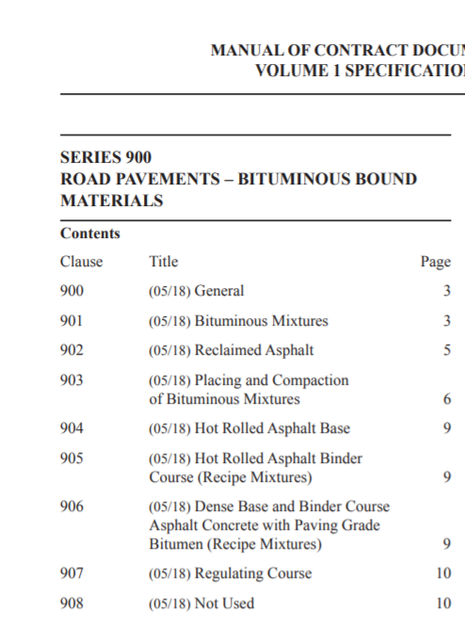
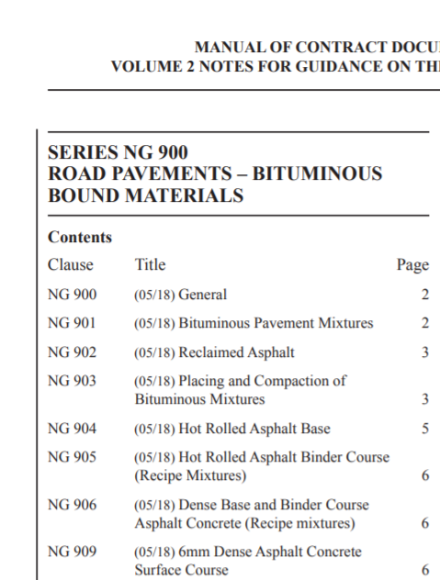
Old content and presentation of SHW and NfG (1/3)
Notes:
I’m now going to show the new presentation of the volumes 1 and 2… On this slide we can see a Volume 1 specification and related Volume 2 Notes for guidance. In this case the titles of the sections match up between the two documents.

Slide 28
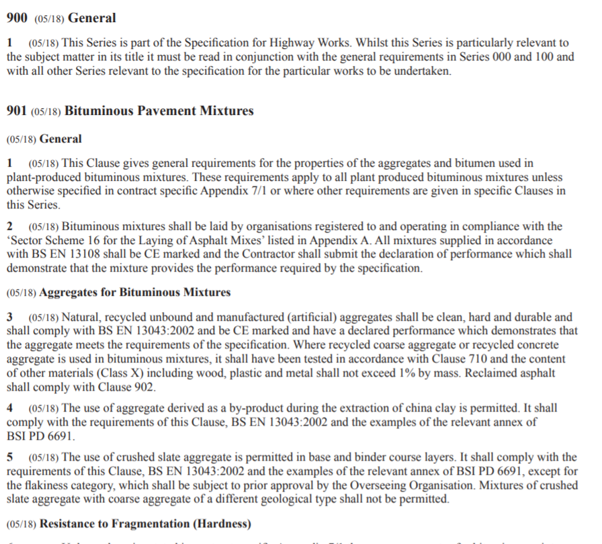
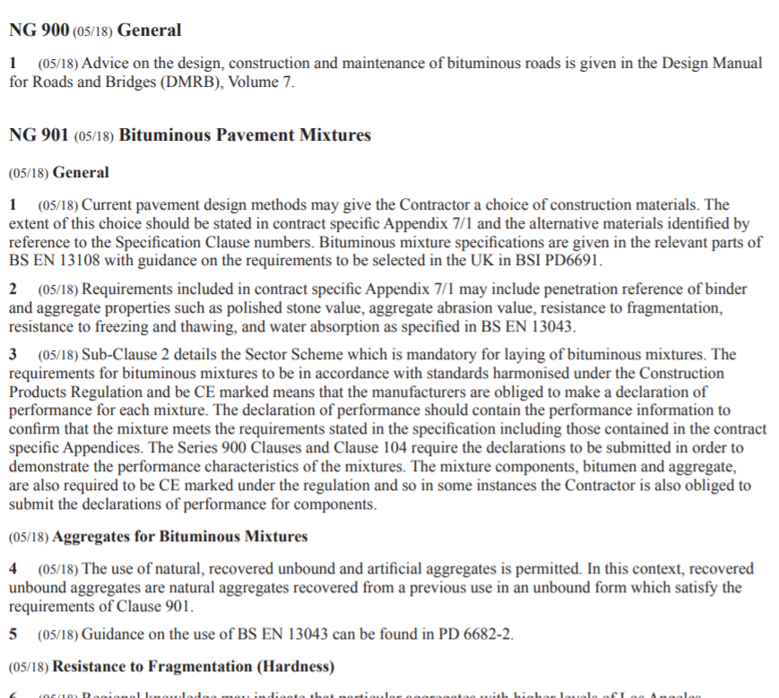
Old content and presentation of SHW and NfG (2/3)
Notes:
In some cases the subtitles match up too like on this slide… We can also see that requirements are not split out: we have paragraphs full of text which can contain multiple requirements or, in the case of the Notes for guidance, multiple notes.

Slide 29
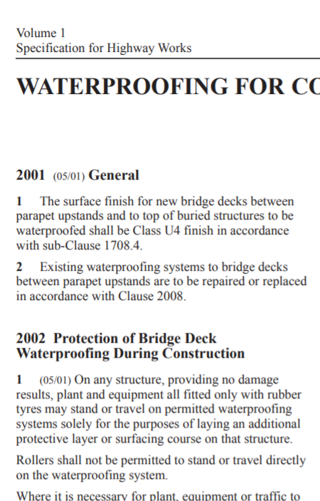
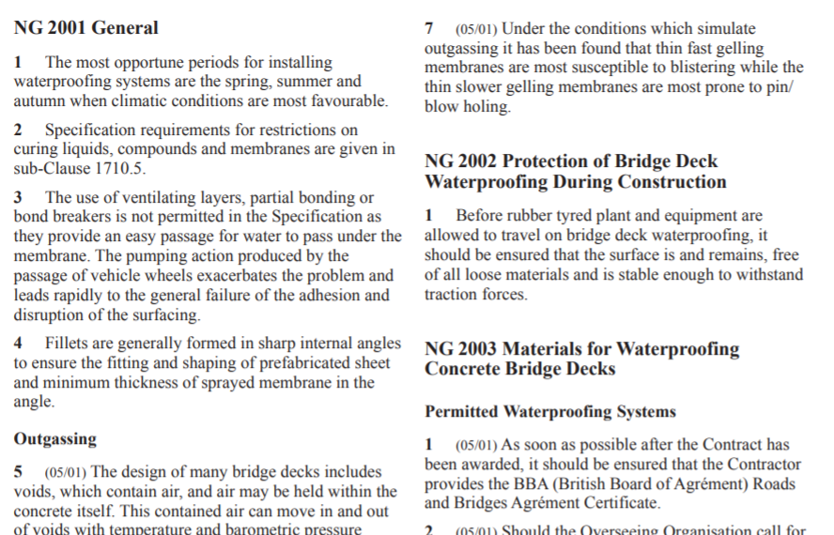
Old content and presentation of SHW and NfG (3/3)
Notes:
In some cases the sub-titles don’t match up like on this slide… In short, there are inconsistencies in the way content is currently structured. In future we’ll follow a much more rigorous approach as shown on the next couple of slides…

Slide 30
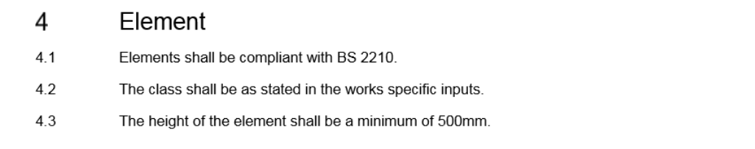
New content and presentation of SHW
SHW requirements will be split out.
SHW requirements will only cover:
products;
materials;
activities related to products and materials
Notes:
This Figure provides an example of content of Specification for Highway Works form of document.
Firstly, SHW requirements will be split out, so we’ll no longer have long paragraphs and multiple requirements in the same clause. Secondly, SHW requirements will only cover: products; materials; activities related to products and materials… Activities related to products and materials include:
construction activities required to ensure that products and materials are correctly installed (installation/workmanship requirements);
​verification (including testing and inspection) to prove that products and materials are acceptable;
​documentation to prove that other requirements have been carried out.

Slide 31
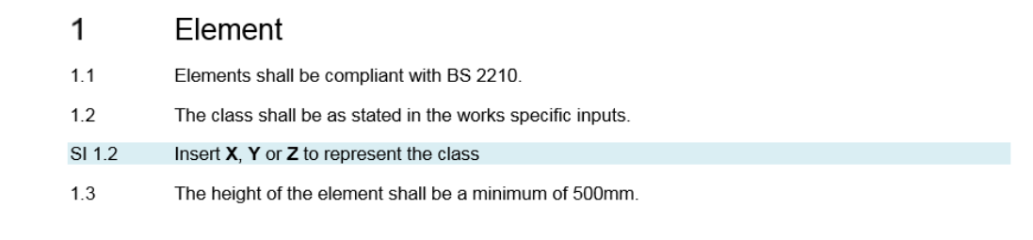
New content and presentation of NfG (now IfS)
Constructor requirements
Specifier instruction
2 documents authored as one
Specifier Instructions will provide the required works specific inputs related to the constructor requirements.
Specifier Instructions aligned with the SHW Requirements and only included where SHW requirements refers to Works Specific Inputs.
Notes:
The Notes for Guidance will change significantly in terms of scope and structure. For ease of use by specifiers, Instructions for Specifiers documents shall be published with both:
the default set of constructor requirements of the SHW and,
the specifier instructions on providing the required works specific inputs related to the constructor requirements.
The specifier is not expected to adhere to the constructor requirements, these are provided for information only…
Specifier Instructions will be aligned with the SHW Requirements and only included where SHW requirements refers to Works Specific Inputs as you can see in this example.

Slide 32
Changes to content, structure and presentation of the MCHW
Future
MCHW
Introductory documents
Works Specification
DMRB construction row
Bill of quantities
Instructions for Specifier (IfS) documents
Specification for Highways Works (SHW) documents
Potentially new row in DMRB matrix
Constructor requirements
Standard Drawings
What the DDP needs to consider
* Works specific inputs replace Contract specific appendixes
Notes:
To summarise the key changes to content, structure and presentation of the MCHW:
We are moving away from having separate NfG documents - authors will be authoring the 2 together hand in hand
Constructor requirements will be published as SHW documents within the DMRB construction row (see purple box)
The IfS document will be the combined document for the use by the specifier, instructions + constructor requirements (see pink box), and will be published within a new row in the DMRB matrix. IfS is the new name of the Notes for Guidance documents

Slide 33
Summary
Content, structure and presentation of the MCHW will change.
DMRB documents may need to be updated (or new documents created) to provide design information currently within the MCHW.
Sections need to be entirely restructured following specific rules.
Changes to drawings in Volume 3 may be needed to implement the specification requirements
National variations have to be identified.
Notes:
Let’s move on to the second item in this list, i.e. the impact of the MCHW update on the DMRB.

Slide 34
Issue
The NfG documents currently contain design information that needs to be migrated to the DMRB.
In some cases, NfG documents also contain constructor requirements that need to move to the SHW.
The SHW series contain, in limited cases, design requirements that need to be migrated to the DMRB.

Slide 35
When undertaking a preliminary screening of your documents…
Ask the question: what is that requirement / advice for?
If it covers a design activity / decision, needs to move to the DMRB
If it covers products, materials or activities related to products and materials relevant to construction, needs to move to the SHW
If it covers the information that needs to be included in the work specific inputs in order to specify fully relevant objects or materials, needs to move to the IfS
We want the specifier instructions to present the outcome of the design into a clear format, not to give guidance on design decisions.
Notes:
We want the specifier instructions to present the outcome of the design into a clear format, not to give guidance on design decisions… This is a key change for you to understand as it will affect the way in which you will review and update Volume 2… The future IfS documents will provide pure instructions to be translated into works specific inputs, and not guidance on design activities or decisions. Firstly, because such content is relevant to the designer and needs to be provided in the right place in the DMRB matrix. Secondly, and more importantly, because this approach will open the door to automating this process in future and populating the spec directly from the 3D model… BIM is changing the way information is produced and we want to respond to industry change by making the future MCHW compatible with asset information strategies and supporting our digital roads vision… Therefore, no human interpretation will be needed to use the specifier instructions in future, and no guidance associated with design decisions will need to be provided in conjunction with the specifier instructions… The question is ‘How to define a design activity or decision’… I’ll illustrate this point in the next slide.

Slide 36
How to define design activity / decision
Examples of typical design activities / decisions which should be taken by the designer, not the specifier:
Choices on classes
Choices that affect performance
Selection / optimisation against multiple criteria
Decisions which affect other products / materials / activities related to products and materials (i.e. interfaces)
Notes:
To identify a design activity or decision, you have to look for the following examples of typical design activities / decisions which should be taken by the designer, not the specifier: … let’s see an example.

Slide 37
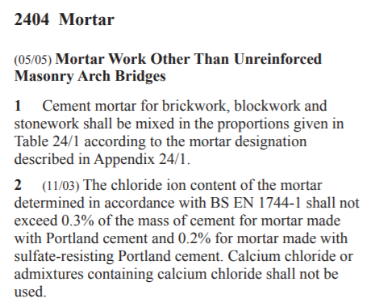
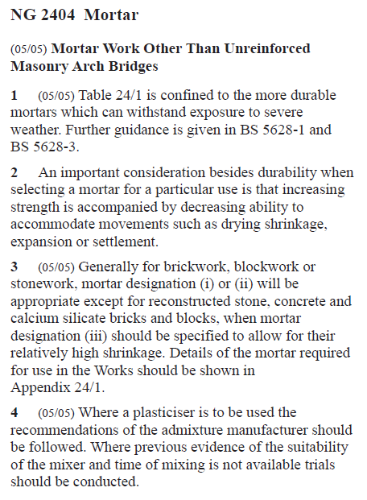
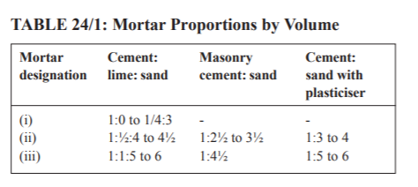
This is background information and explains the scope of Table 24/1. Relevant to the designer if a project specific requirement is needed.
This provides background on how to make a design choice. It points out that multiple criteria need to be considered to make a choice.
This is a recommendation for design choice.
This is relevant to the specifier and will become the specifier instruction SI 1.1 – needs to be rephrased.
This needs to be split into two constructor requirements. To rephrase and move to the SHW.
Notes:
In summary, this example shows how design decisions are currently provided within the NfG and that previously no rigorous attempt was made to separate compilation of specification and production of details to be compiled.

Slide 38
How to manage design content provided in the MCHW
Identify relevant design documents or decide to create new ones
Provide design content within the background commentary against relevant design documents (when covering background information or statements of facts / notes);
Move design content into relevant design documents or develop new ones.
The DDP should assess the value of each option and make specific recommendations on the way forward.
Consider that, if the content is going to be migrated to the DMRB, this will be associated with relevant requirements.
Notes:
To manage design content provided in the MCHW, you have to: …

Slide 39
Summary
Content, structure and presentation of the MCHW will change.
DMRB documents may need to be updated (or new documents created) to provide design information currently within the MCHW.
Sections need to be entirely restructured following specific rules.
Changes to drawings in Volume 3 may be needed to implement the specification requirements
National variations have to be identified.
Notes:
We have seen the new content, structure and presentation of the MCHW, and the impact of the MCHW update on the DMRB. Let’s move on to the third item in our list, which covers how sections need to be restructured.

Slide 40
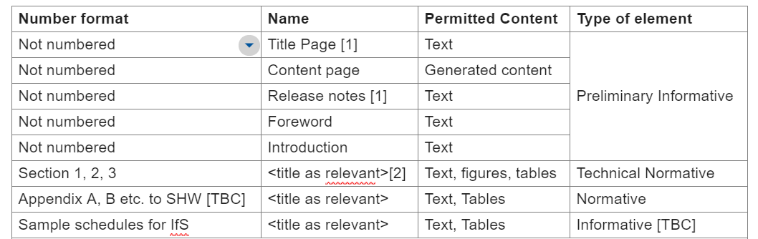
Document layout
These sections do not contain requirements, only general advisory information without the MCHW numbering layout.
These sections contain the clause numbering system to present requirements.
Notes:
The future SHW and IfS documents will follow a standard layout shown on this slide. The initial sections are not numbered, then from section 1 you will start introducing the clause numbering system to present requirements / instructions. Please note that there is not Scope section, which was introduced for DMRB documents, because it is not relevant to the MCHW documents. Also, appendices to the SHW documents are likely to disappear, more details will be provided at the training for authoring.
When drafting IfS documents, sample schedules will be developed. The drafting rules will be presented at the training for authoring.

Slide 41
High-level principles
Sections shall be organised such that:
all requirements within that section apply to the physical object, material, activity or collective term that is the subject of the title;
Notes:
There are 6 principles you have to understand to restructure sections … Firstly, all requirements within a section apply to the physical object, material, activity or collective term that is the subject of the title.

Slide 42
Section title
The title of sections (with the exception of section titles of introductory documents) shall either refer to:
a physical object, material, defined area of the site or activity; or
a collective term for objects, materials, defined areas of the site or activities.
For example a collective term for "vehicle restraint systems" and "pedestrian restraint systems" is "road restraint systems".
Need to introduce appropriate titles to support cross referencing – see following slides
In future, cross referencing will be done by titles, not numbers.
Notes:
For example a collective term for "vehicle restraint systems" and "pedestrian restraint systems" is "road restraint systems“…
Where the subject of the section is an object, such as a brick, all the requirements within the section apply to bricks. Furthermore, if a brick is presented in the works graphical information, i.e. drawings, and the section is referenced, all the requirements of the section would apply to that brick in the works graphical information.

Slide 43
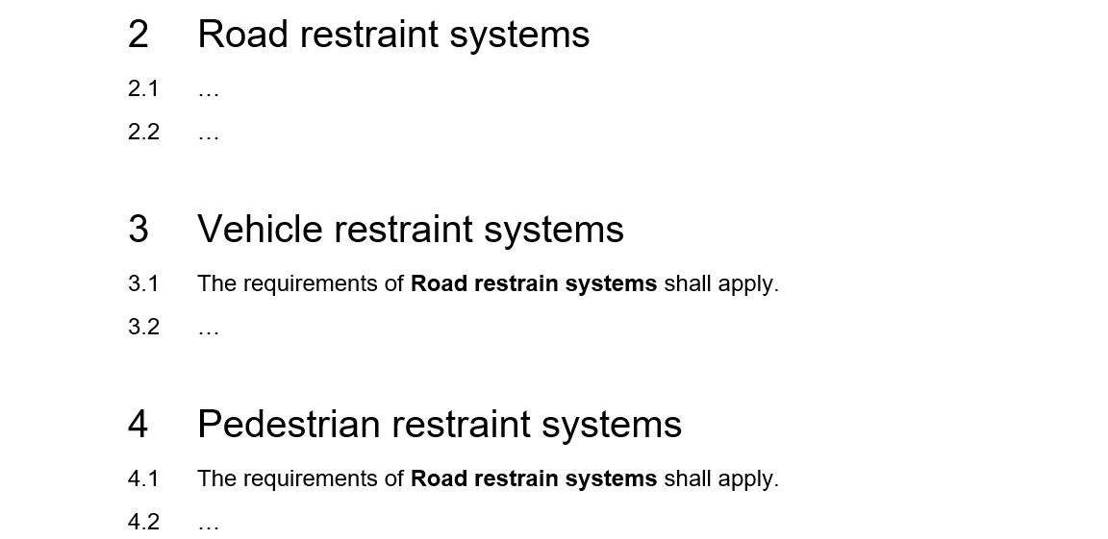
Appropriate titles to support cross referencing
1. Set of requirements common to more than one section.

Slide 44
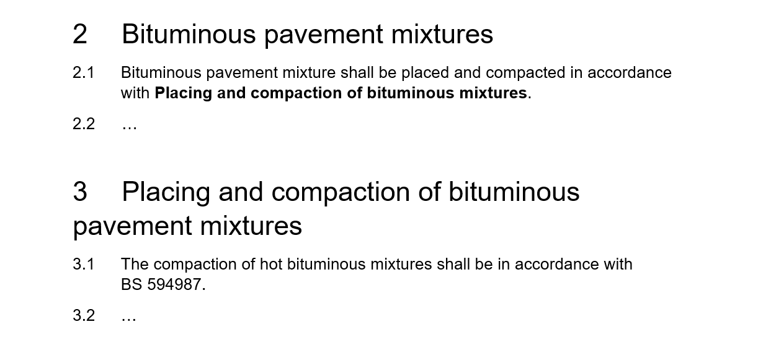
Appropriate titles to support cross referencing
2. Set of requirements on a particular activity, material or product associated with another section
Notes:
Add pavement to section 3

Slide 45
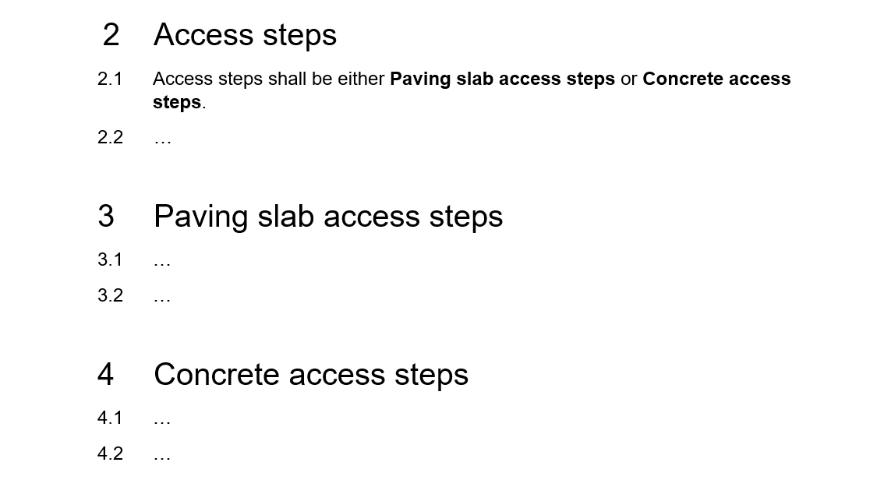
Appropriate titles to support cross referencing
3. Set of requirements presented as an option within another section
Notes:
The example used is technically incorrect in that access steps can be any acceptable material not just paving slabs or concrete, the term ‘paving slabs’ could give an inconsistency with other parts of Series 1100 where they are called flags. The use of a technically incorrect example can be distracting. The technology team has recently been looking at access steps.

Slide 46
High-level principles
Sections shall be organised such that:
all requirements within that section apply to the physical object, material, activity or collective term that is the subject of the title;
each section can be mapped to drawings/BIM models;

Slide 47
How the updated SHW will interact with drawings/BIM models
The design drawings/BIM model detail what materials and products have been specified and where they are to be placed.
We want to enable direct mapping between the BIM model/drawing and the specification.
Notes:
The design drawings/BIM model are a key output from the design. They detail what materials and products have been specified and where they are to be placed… Coming back to what Becky was saying about enabling future longer term efficiencies, and specifically supporting asset information strategies and future trends, we want to enable direct mapping between the BIM model/drawing and the specification. Let’s see an example…

Slide 48

How the updated SHW will interact with drawings/BIM models
Want to avoid this
Notes:
In this slide you can see an example of how current content is provided. In this case, safety barriers and terminals are provided within the same section, which makes it difficult to have a one to one link between the drawings / BIM models and the relevant requirements. We want to avoid these situations.

Slide 49
How the updated SHW will interact with drawings/BIM models
Align titles with objects and materials which are likely to be shown and referred to on a drawing/BIM model
Notes:
What you need to do is to align titles with objects and materials which are likely to be shown and referred to on a drawing/BIM model as in this example.

Slide 50
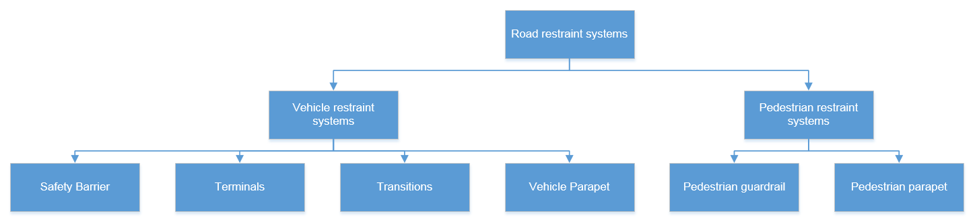
How the updated SHW will interact with drawings/BIM models
Think about what the bottom level is
List of all relevant materials or objects
Notes:
From a practical point of view, when reviewing the sections in your documents you have to go step by step down in terms of level of detail, from systems to specific products and materials. All you need to think about at this stage is what the bottom level is. In this way, you will produce a list of all of materials and objects that are needed to be constructor requirements and ultimately in the BIM model.

Slide 51
High-level principles
Sections shall be organised such that:
all requirements within that section apply to the physical object, material, activity or collective term that is the subject of the title;
each section can be mapped to drawings/BIM models;
​product and installation (workmanship) requirements are distinguished;

Slide 52
Product and installation (workmanship) requirements
​Requirements shall be organised such that it shall be possible to make a distinction between:
product requirements
installation (workmanship) requirements
Making a clear distinction between installation (workmanship) and product requirements allows a clear specification of verification requirements.
Notes:
Requirements shall be organised such that it shall be possible to make a distinction between: product requirements and installation (workmanship) requirements, possibly within separate sections or under different sub-headings. With a few exceptions, product legislation, product standards, product certification and acceptance do not apply to the installed product, only to the product as it arrives on site.
Making a clear distinction between installation (workmanship) and product requirements also allows a clear specification of verification requirements, which is our next principle.

Slide 53
High-level principles
Sections shall be organised such that:
all requirements within that section apply to the physical object, material, activity or collective term that is the subject of the title;
each section can be mapped to drawings/BIM models;
​product and installation (workmanship) requirements are distinguished;
verification requirements ​can be easily identified;

Slide 54
Verification requirements
Verification requirements shall be organised so that it is possible to distinguish between acceptance criteria for products coming to site (at the gate) and contract compliance verification.
​Verification requirements related to a single method of verification shall be grouped under a section heading or a sub-section heading.
Where verification requirements are to be referenced from other sections, they shall be grouped under their own section title.
Notes:
Verification requirements are those related to the assessment of whether other requirements have been fulfilled. Examples of verification requirements include requirements to conduct testing or inspection… Verification requirements shall be organised so that it is possible to distinguish between acceptance criteria for products coming to site (at the gate) and contract compliance verification... This allows distinction between applying acceptance criteria to products, which would be governed and constrained by legislation and the status of product standards, and verification that the works have been completed/installed correctly which can be requested by the Overseeing Organisation for all works. There may be some changes here with Brexit, this will be covered in the training for authoring as needed… From a practical point of view, verification requirements related to a single method of verification shall be grouped under a section heading or a sub-section heading. Where verification requirements are to be referenced from other sections, they shall be grouped under their own section title.

Slide 55
High-level principles
Sections shall be organised such that:
all requirements within that section apply to the physical object, material, activity or collective term that is the subject of the title;
each section can be mapped to drawings/BIM models;
​product and installation (workmanship) requirements are distinguished;
verification requirements ​ can be easily identified;
documentation requirements can be easily identified;
Notes:
The fifth principle is that sections shall be organised such that documentation requirements can be easily identified

Slide 56
Documentation requirements
Documentation requirements related to a single documentation submission shall be grouped under a section heading or a sub-section heading.
Where documentation requirements are to be referenced from other sections, they shall be grouped under their own section title.
Notes:
A documentation requirement is one related to the submission of documentation to the Overseeing Organisation.

Slide 57
High-level principles
Sections shall be organised such that:
all requirements within that section apply to the physical object, material, activity or collective term that is the subject of the title;
each section can be mapped to drawings/BIM models;
​product and installation (workmanship) requirements are distinguished;
verification and documentation requirements can be easily identified;
documentation requirements can be easily identified;
requirements for materials or physical objects which already exist in the site prior to the works starting can be easily identified.
Notes:
The last high-level principle is about requirements on materials or physical objects which already exist in the site prior to the works starting. We want such requirements to be identified in future MCHW documents.

Slide 58
Existing objects and materials
Requirements which only apply to materials or physical objects which already exist in the site prior to the works starting shall not be contained in the same section as those which apply to new materials or physical objects.
The use of the word "existing" should be used in section titles to identify materials or physical objects which already exist in the site.
Please contact TAGG for guidance on when the distinction between new and existing materials or physical objects is relevant and how it can be presented.
Notes:
Requirements which only apply to materials or physical objects which already exist in the site prior to the works starting shall not be contained in the same section as those which apply to new materials or physical objects… The use of the word "existing" should be used in section titles to identify materials or physical objects which already exist in the site… Please contact TAGG for guidance on when the distinction between new and existing materials or physical objects is relevant and how it can be presented. The distinction between new and existing materials or physical objects cannot be easily identified in all cases, for example when dealing with earthworks or transition between existing and new objects.

Slide 59
Summary
Content, structure and presentation of the MCHW will change.
DMRB documents may need to be updated (or new documents created) to provide design information currently within the MCHW.
Sections need to be entirely restructured following specific rules.
Changes to drawings in Volume 3 may be needed to implement the specification requirements
National variations have to be identified.
Notes:
We have seen the new Content, structure and presentation of the MCHW, the impact of changes to the MCHW on the DMRB, and the rules to restructure sections. The fourth area that is important for you to understand is about changes to drawings in Volume 3, which may be needed to implement the specification requirements.

Slide 60
What is happening with the Volume 3 drawings
Work is ongoing to set the directions of the future Volume 3.
The current Volume 3 drawings will become either:
Updated technical drawings in the DMRB
Updated technical drawings in the SHW documents
Updated technical drawings retained in a separate set
Removed and not replaced
Notes:
There is work on going to define the future directions of Volume 3 Highways construction details… There are 4 options for the content of volume 3: technical drawings will be updated and moved to the DMRB; technical drawings will be updated and moved to the construction row in the DMRB matrix, which will cover SHW documents; technical drawings will be updated and retained in a separate set; technical drawings will be removed and not replace.

Slide 61
Updates to drawings contained in Volume 3
At this stage you have to identify status of each Volume 3 drawing within your discipline. Consider the following:
is it a reference design or an object to be specified?
is it out of date but still relevant or obsolete?
is a 2D drawing still the most appropriate way of communicating the intent / requirement?
are new drawings potentially needed?
is it used more commonly on local authority roads (consider Northern Ireland needs)?
is it commonly used?
could it restrict innovation?
Stakeholder engagement might be required to fully understand the answers to these questions (this shall be noted in the DDP)
Notes:
Independently of the option, we would like you to identify the status of each Volume 3 drawing within your discipline at DDP stage considering the following aspects: (…)

Slide 62
Updates to drawings contained in Volume 3
At this stage, you have to identify relevant location of drawings. Consider the following:
Does it relate to an object or material identified within the SHW?
Is it better placed in the DMRB as relevant to design?
This shall be noted in the Document Development Plan.
Notes:
We would also like you to identify relevant location of drawings, considering the following: (…)

Slide 63
Summary
Content, structure and presentation of the MCHW will change.
DMRB documents may need to be updated (or new documents created) to provide design information currently within the MCHW.
Sections need to be entirely restructured following specific rules.
Changes to drawings in Volume 3 may be needed to implement the specification requirements
National variations have to be identified.
Notes:
The final item in this sessions is about national variations that have to be identified at DDP stage.

Slide 64
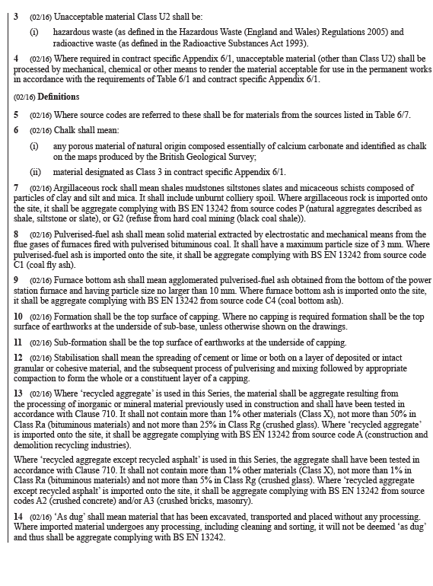
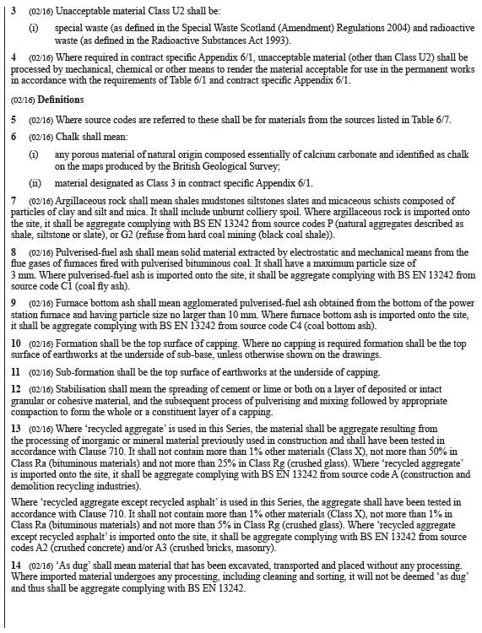
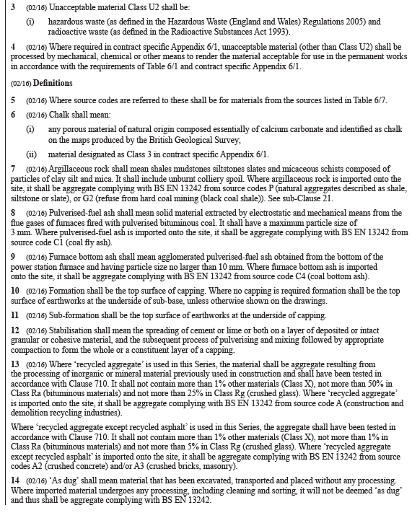
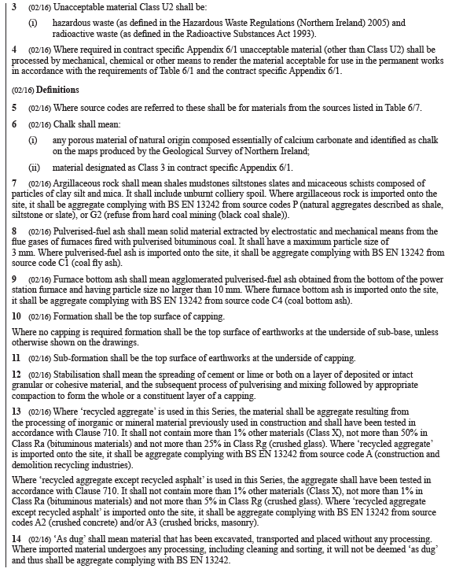
Example of national variations
Different regulation
HE (main text)
TS
WG
NI

Slide 65
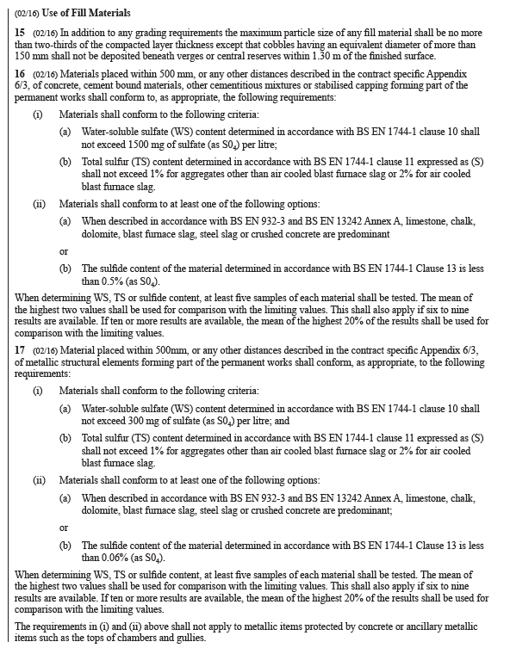
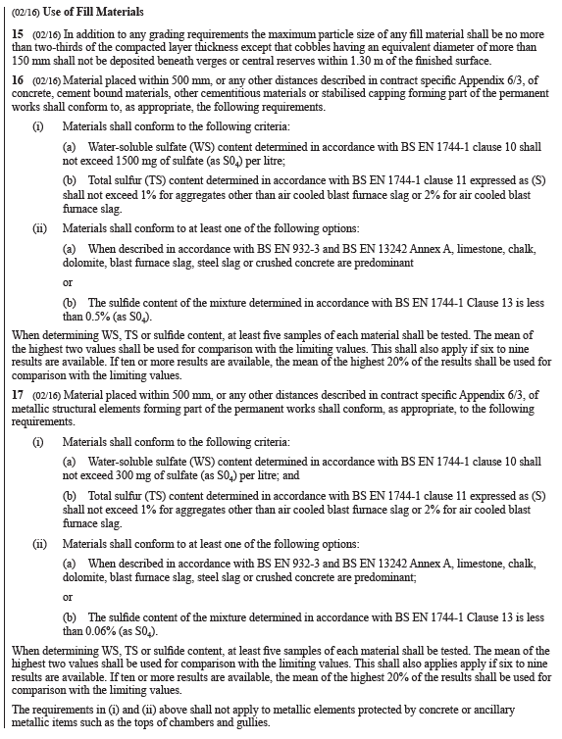
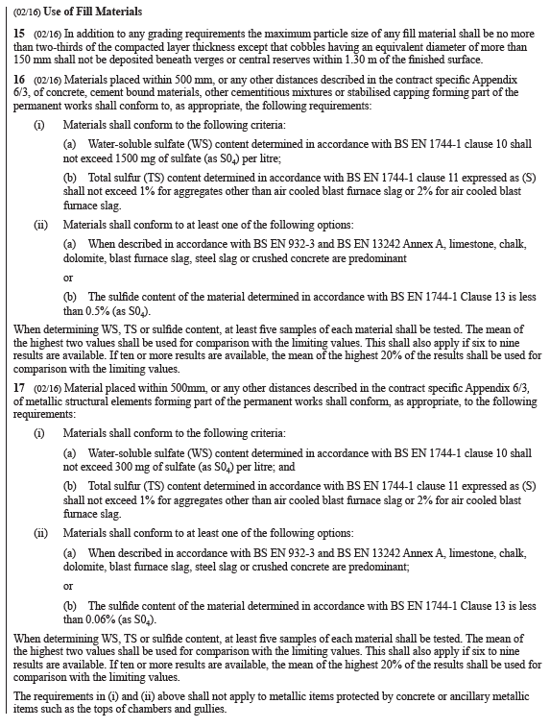
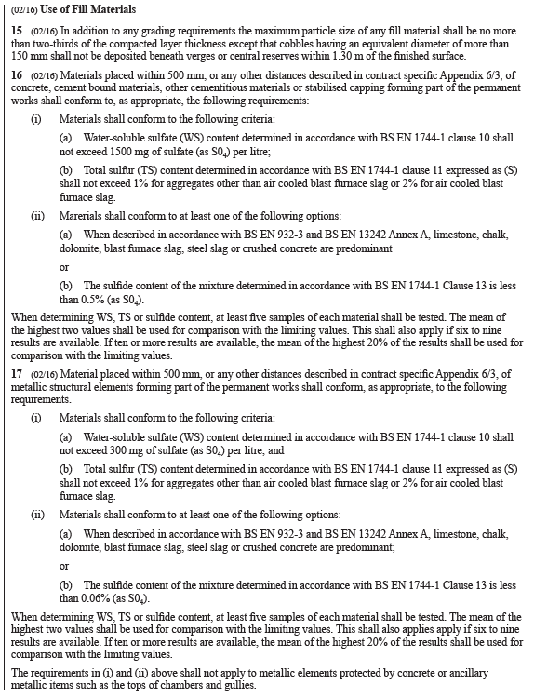
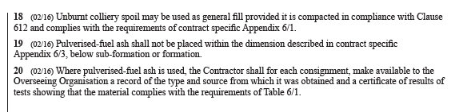
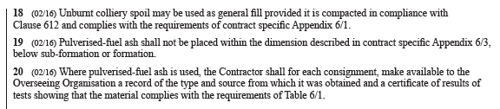
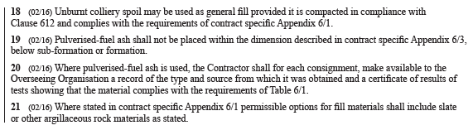
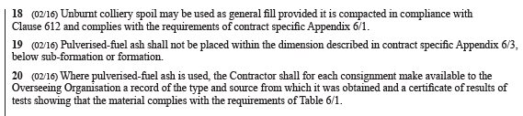
Example of national variations
Additional requirement
HE (main text)
TS
WG
NI

Slide 66
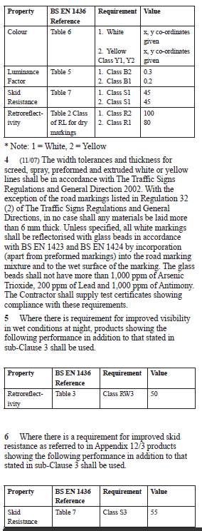
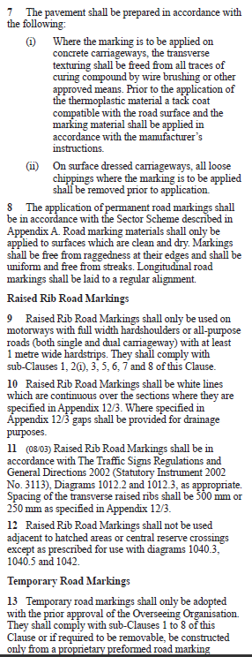
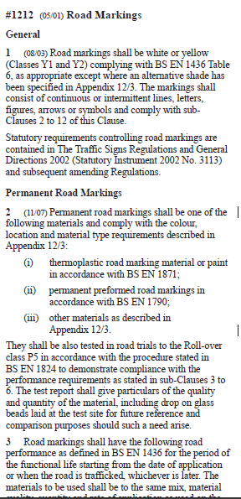
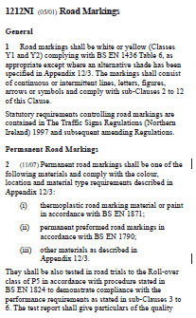
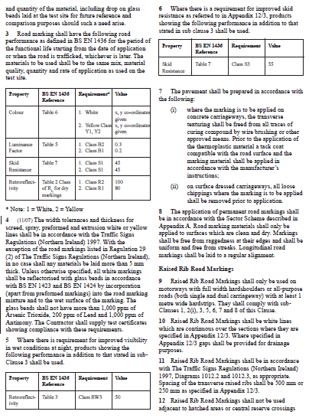
Example of national variations
Different regulations
HE (main text)
TS / WG

Slide 67
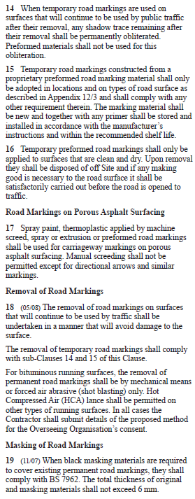
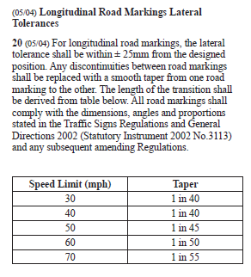
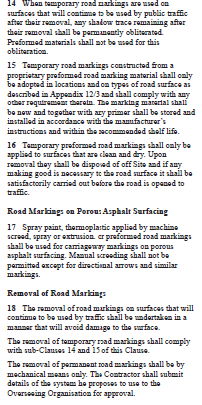
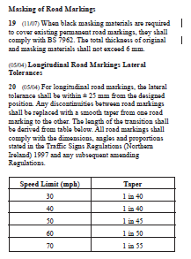
Example of national variations
Different regulations
Modification to a requirement contained in the main text
HE (main text)
TS / WG

Slide 68
National variations
At this stage, you have to identify current national variations and check those that are needed (e.g. for different legislative rules) and those that could be removed.
Please start discussing with our counterparts in the Devolved Administrations now and agree whether national variations can be removed or should be retained.
In the future MCHW, national variations will be called “Nationally Determined Requirements” (NDR) or “Nationally Determined Sections” (NDS).
Notes:
At this stage, you have to identify current national variations and check those that are needed (e.g. for different legislative rules requirements) and those that could be removed.
Please start discussing with our counterparts in the Devolved Administrations now and agree whether national variations can be removed or should be retained.
In the future MCHW, national variations will be called “Nationally Determined Requirements” (NDR) or “Nationally Determined Sections” (NDS). This depends on whether there is limited, small variation (which can be presented at requirement level) or significant variation (which will require an entire section to be presented). How the NDRs/NDSs will be presented in the published version is under discussion and will communicated in due course. This however will not affect the drafting rules that will be presented in March next year.

Slide 69
Closing remarks
Notes:
To conclude this training session, let me provide some closing remarks.

Slide 70
Summary of key points
Our vision for the future MCHW is to provide clear and unambiguous requirements and instructions, compatible with modern contract forms and future construction practices.
There will be a new content, structure and presentation of the MCHW.
You have to undertake a preliminary screening of the document and identify design content, which in turn has to move from the NfG (and in limited cases from the SHW) to the DMRB.
You need to understand the high-level principles underpinning the structure of new documents and how sections will need to be updated.
You have to undertake a preliminary screening of Volume 3 drawings and check their status and relevant location.
You have to identify national variations and start engagement with the other Overseeing Organisations.
Notes:
Our vision for the future MCHW is to provide clear and unambiguous requirements and instructions, compatible with modern contract forms and future construction practices. Becky presented vision, the specific recommendations which will guide the future MCHW, and the practical implications.
There will be a new content, structure and presentation of the MCHW… I showed you the 7 documents and how their content will be redrafted into Introductory documents, SHW documents, Instructions for Specifier (IfS) documents, drawings and bill of quantities. SHW and IfS will be located in the DMRB matrix, the location of the other content will be confirmed soon... I also showed the presentation of SHW requirements, shorter and clearer. Similarly for the IfS, which will be authored and presented in line with SHW requirements for ease of use…
You have to undertake a preliminary screening of the document and identify content related to design activity/decision, which in turn has to move from the NfG (and in limited cases from the SHW) to the DMRB. I explained what we mean with design activity/decision and I presented a practical example which showed the challenges in current NfG. You have to check whether you have an existing DMRB document covering the design information contained in the MCHW, or whether new documents may need to be created. This preliminary assessment at DDP stage will be refined during the drafting stage...
Forth, you need to understand the high-level principles underpinning the structure of new documents and how sections will need to be updated. I talked to you about the 6 high-level principles to restructure the SHW sections…
You have to undertake a preliminary screening of Volume 3 drawings and check their status and relevant location…
Finally, you have to identify national variations and start engagement with the other Overseeing Organisations.

Slide 71
DDP: key aspects to be addressed
 | Section in the DDP template | What you need to know
1 | Key dates for document development | Jira milestones
2 | Production team | Key names / contacts
3 | Deliverables | Relevant when the drafting process will start
4 | Summary of drafting needs and approach | New content structure and presentation of the MCHW Consequential updates to the DMRB Sections to be entirely updated and restructured following specific rules Consequential updates to drawings in Volume 3 Identification of national variations
5 | Interfaces with other documents and coordination required
6 | High-level section review
7 | Proposed outline document structure
8 | Risks and opportunities
Notes:
Understanding these aspects is essential to understand the DDP content and how to populate it, specifically sections 4 to 8 which I introduced at the start of this presentation.

Slide 72
Support provided
Audio file of this presentation
DDP template
FAQ with answers to your questions
Interim review (see next slides)
MDD rules issued in March 2021
Training for authoring in March 2021
Please send any comments on DDP to PM Gareth Smith Gareth.Smith@highwaysengland.co.uk
Content specialists:
Kate Albon Kathleen.Albon@highwaysengland.co.uk
Simon Hartshorne Simon.Hartshorne2@highwaysengland.co.uk
For any Jira queries, please contact SFP Manager Becky Axtell Rebecca.Axtell@highwaysengland.co.uk
Notes:
In terms of support provided, we will share …
Please send any comments on DDP to PM Gareth Smith. For those of you who do not know Garteth, he is a new member of the Technical Assurance and Governance Group and will be leading on this task as PM for the MCHW work. When the drafting process will start, you will also be supported by Kate Albon and Simon Hartshorne as content specialists.
For any Jira queries, please contact Beck Axtell, who is the SFP manager for both DMRB and MCHW documents. Please note that the governance process is going to change, but this will not affect your work on the DDP, I just wanted to give you a preliminary notice. The new streamlined governance process will be presented into a separate training and announced by specific comms.

Slide 73
Next steps
Development of DDP by document owners
Collaborative planning workshop with document owners (Nov 2020)
Procurement of external suppliers (if needed)
Training for authoring delivered in March 2021
MDD issued in March 2021
Full roll out of the MCHW work programme starting on 1st April 2021

Slide 74
What you need to do now…
Produce DDP of all documents by end of March 2021
You do not have to think about numbering of documents now, rules will come later
Interim review:
Need to have an advanced version of draft DDPs ready to share with Gareth Smith by 15th of January
Workshops will be held for each discipline at the beginning of February – dates will be confirmed soon.
Opportunity to provide feedback and share lessons, which will inform MDD rules and training for authoring
Please report any comments and queries to Gareth Smith.

Slide 75
Deliverables
SHW document and associated instructions for specifiers, sample appendices for works specific inputs, drafts of associated changes to Volume 3 drawings, and all other amendments required to implement the specification amendments
Draft Nationally Determined Requirements or Sections, if needed
Draft new DMRB document(s) or new / updated clauses for existing DMRB documents to provide design information currently within the Notes for Guidance, if needed
Background document and change log
Validation of constructor requirements
Other deliverables as required from the work package
Notes:
…
iv. TAGG will be inputting the printed versions into CARS for use when developing change logs. They will not be in a format that can be used to develop the new MCHW documents and users will be expected to develop the new documents on the new template.
v. ​Validation of constructor requirements - we want to make sure that, in the future MCHW, verification and documentation requirements are clearly linked to constructor requirements for validation purposes. CARS will have a functionality to create a link between constructor requirements and related verification and documentation requirements.

Slide 76
Thank you
Notes:
Thank you very much all for attending this training session and thank you Becky for presenting the vision for the future MCHW and some of the key practical implications. We have been collecting your questions throughout the presentation. We have 5 minutes left to answer some of them, we’ll share the answer to the other into an FAQ, please send your comments to Gareth Smith.

